Slide 1
Chapter 15
Nervous System Diseases
and Disorders
Notes:
1

Slide 2
Learning Objectives
Discuss the basic anatomy and physiology of the nervous system.
Identify the important signs and symptoms associated with common nervous system disorders.
Describe the common diagnostics used to determine the type and cause of nervous system disorders.
Identify some common disorders of the nervous system.

Slide 3
Anatomy and Physiology
Nervous system
  Brain, spinal cord, and nerves
  Central nervous system (CNS)
    Brain
    Spinal cord
  Peripheral nervous system (PNS)
    Autonomic nervous system
    Cranial and spinal nerves
Notes:
3

Slide 4
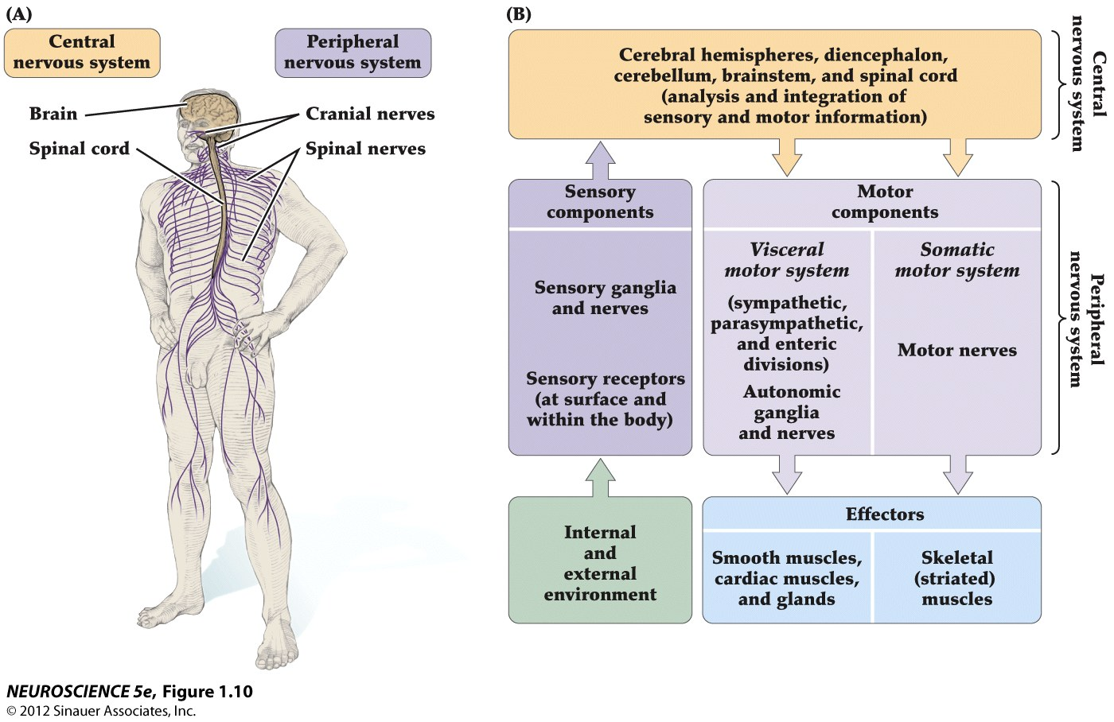
Major Components and Relationships of the CNS and PNS

Slide 5
Common Signs and Symptoms
Headache
Nausea and vomiting
Weakness
Mood swings
Fever
Notes:
5

Slide 6
Common Signs and Symptoms
Symptoms specific to CNS:
  Stiffness in neck, back, or extremities
  Inability to move any part of body
  Seizures or convulsions
  Paralysis
  Visual difficulties
Notes:
6

Slide 7
Common Signs and Symptoms
Symptoms specific to CNS: (continued)
  Inability to speak
  Paralysis
  Extreme or prolonged drowsiness
  Stupor, unconsciousness
  Amnesia or extreme forgetfulness
Notes:
7

Slide 8
Diagnostic Tests
Cerebrospinal fluid
Measurement of intracranial pressure
X-rays of skull and vertebral column
Myelogram
Angiogram
Electroencephalography (EEG)
CT and MRI
Notes:
8

Slide 9
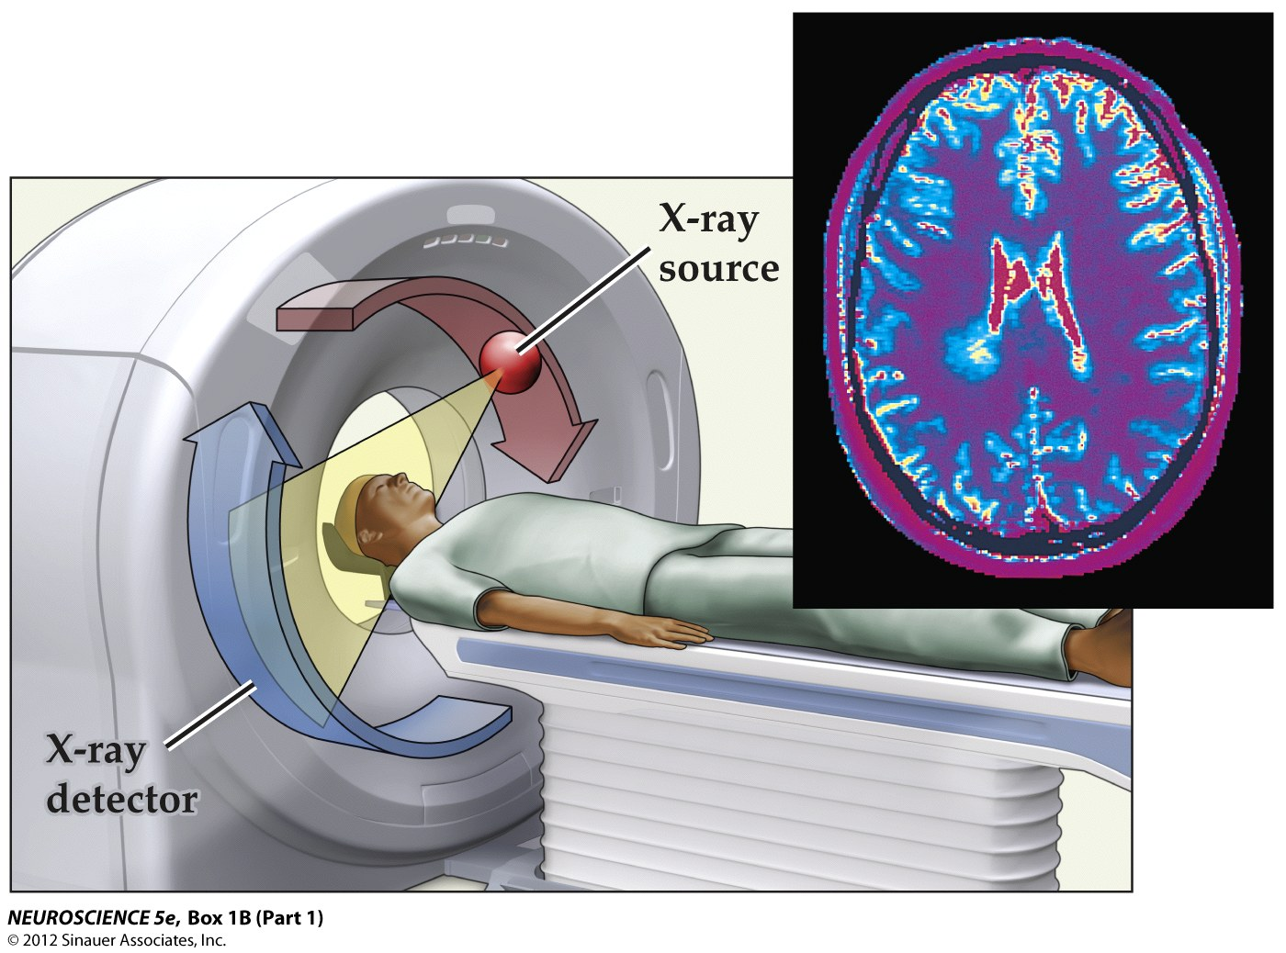
CT Scan

Slide 10
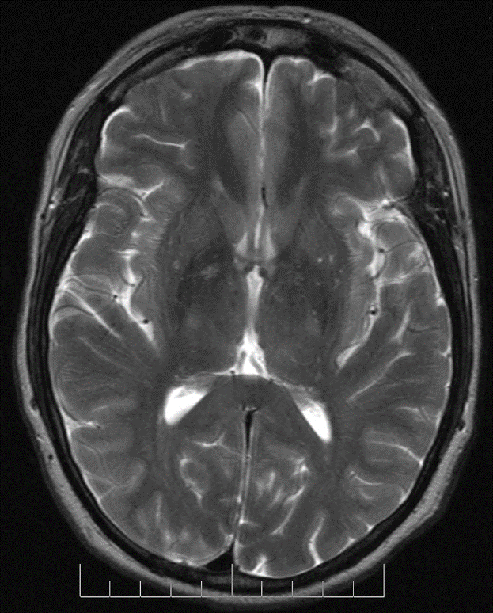
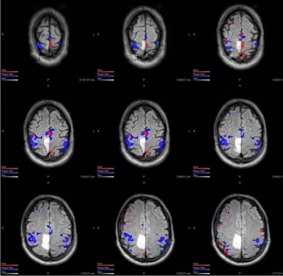
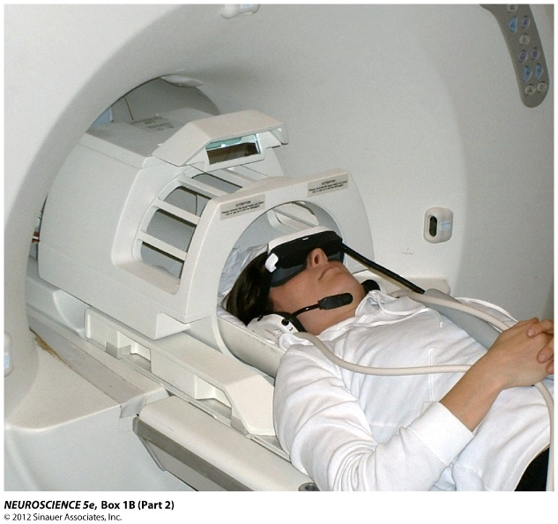
Magnetic Resonance Imaging
Normal
Tumor

Slide 11
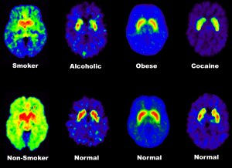
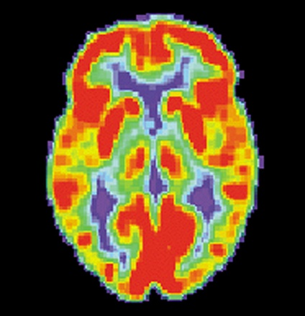
PET Scanning
Measures emissions from radioactively labeled metabolically active chemicals that have been injected into the bloodstream
Emissions are computer processed to 3-D images of distribution of chemicals in the brain

Slide 12
Infectious Diseases of CNS: Encephalitis
Inflammation of brain tissue caused by bacteria and viruses
  Symptoms:
    Headache
    Elevated temperature
    Stiff neck and back
    Lethargy
    Mental confusion
    Coma
  Treatment:
    Treatment is supportive
    Antiviral medication may be effective
Notes:
12

Slide 13
Infectious Diseases: Meningitis
  Inflammation of meninges or coverings of brain and spinal cord
  Causes:
    Bacteria
    Virus
    Fungi
    Toxins
      E.g., lead, arsenic
  Symptoms:
    High fever
    Severe headaches
    Photophobia
    Stiffness and resistance in neck (nuchal rigidity)
    Drowsiness, stupor, seizures
    Coma
Notes:
13

Slide 14
Infectious Diseases: Meningitis
Diagnosis
    Lumbar puncture to find causative agent
Treatment
    Antibiotics for bacterial infection
    Antipyretics
    Anticonvulsants
    Quiet, dark environment
Notes:
14

Slide 15
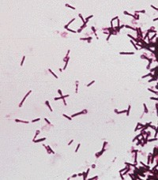
Infectious Diseases: Tetanus
Tetanus
  Highly fatal infection of nerve tissue
  Cause
    Bacteria Clostridium tetani
  First symptom:
    Jaw stiffness
    Commonly called lockjaw
Notes:
15

Slide 16
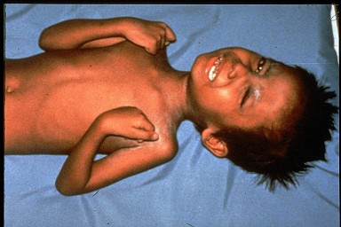
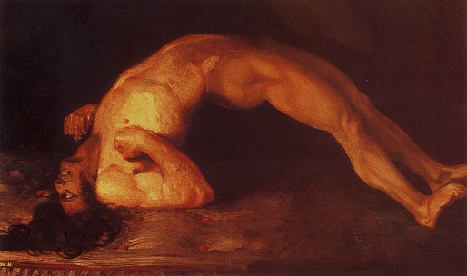
Clostridium tetani

Slide 17
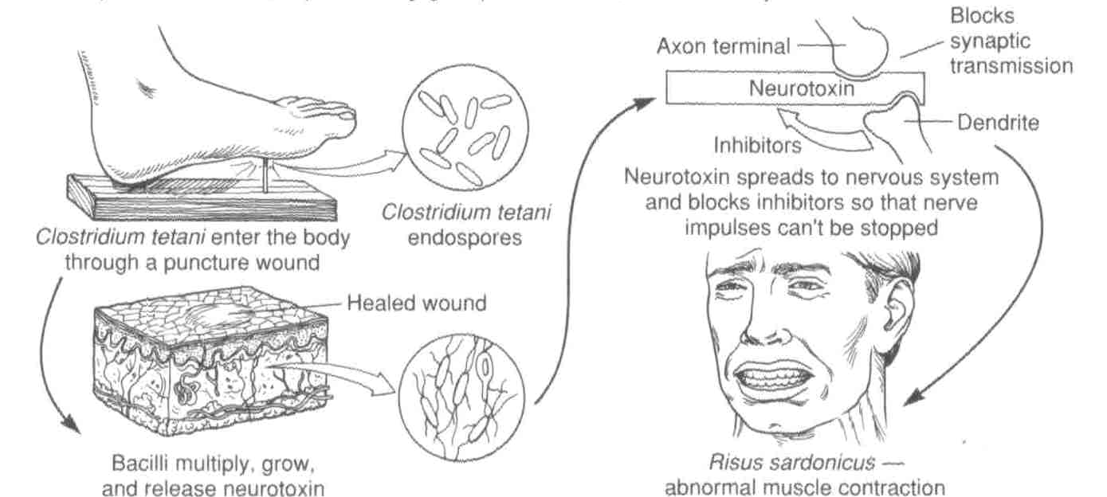
Tetanus Toxin Poisoning: How Does it Happen??

Slide 18
Functional Disorders: Epilepsy
Chronic disease of brain
Intermittent episodes of abnormal electrical activity in brain
Symptoms:
    Seizure and Convulsions
Common types of seizures
      Petit mal
      Grand mal
      Status epilepticus
  Diagnosis by EEG, CT scan, cerebral angiogram, and blood tests
Treatment:
    Anticonvulsive medications
    Close monitoring and adjusting of medication
Notes:
18

Slide 19
Functional Disorders: Parkinson’s disease
Slow, progressive brain degeneration
  Cause is unknown, but may be related to a decrease of brain neurotransmitter – dopamine
Symptoms:
    Rigidity and immobility of hand
    Very slow speech pattern
    Pill-rolling motion of fingers
    Expressionless facial appearance
    Abnormal bent-forward posture
    Short, fast-running steps with shuffling appearance
Symptomatic treatment:
    Dopamine replacement
    Physical and psychological therapy
Notes:
19

Slide 20
Dementias
Loss of mental ability due to loss of neurons or brain cells
Types of dementia
  Senile (old age)
    Alzheimer’s disease – the most common type of senile dementia
    Senile and Alzheimer’s disease are often used synonymously, but they are not the same.
  Vascular
  Head trauma
  Substance induced
Notes:
20

Slide 21
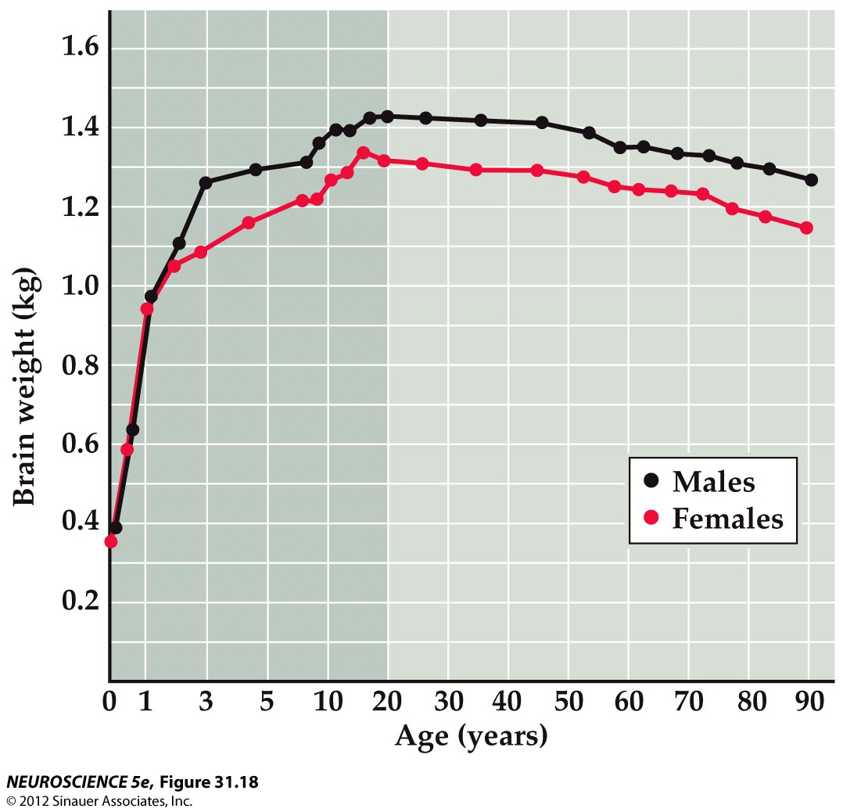
Brain Mass Loss is Normal With Aging

Slide 22
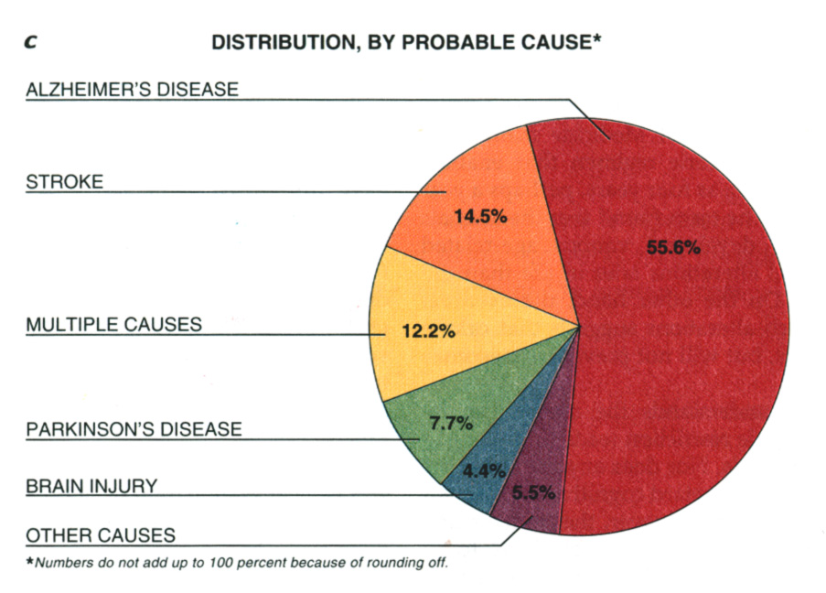
Who gets senile dementia?
45% of people
over 85 develop
dementia
Notes:
Dementia is a syndrome characterized by failure of recent memory and other intellectual functions.
-Alzheimer's disease (AD) is the most common dementia, accounting for 60–80% of cases in the elderly. Of all dementia’s AD is the most common.
Until recently little understanding of the underlying causes. No real means of prevention, no cures.

Slide 23
Dementias: Alzheimer’s disease
  A form of senile dementia
  Usually affects individuals age 70 and older
  Early symptoms:
    Short-term memory loss
    Inability to concentrate
    Slight changes in personality
  Symptoms of disease progression:
    Diminished communication skills
    Meaningless words
    Inability to form sentences
    Increased forgetfulness
    Irritability and agitation
Notes:
23

Slide 24
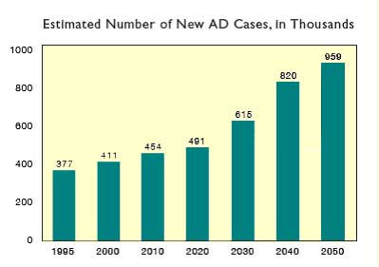
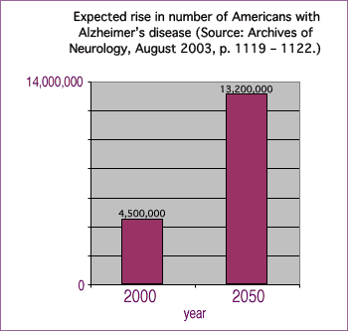
Alzheimer’s Disease: Increasing Numbers
AD will be become an increasing burden on our healthcare industry

Slide 25
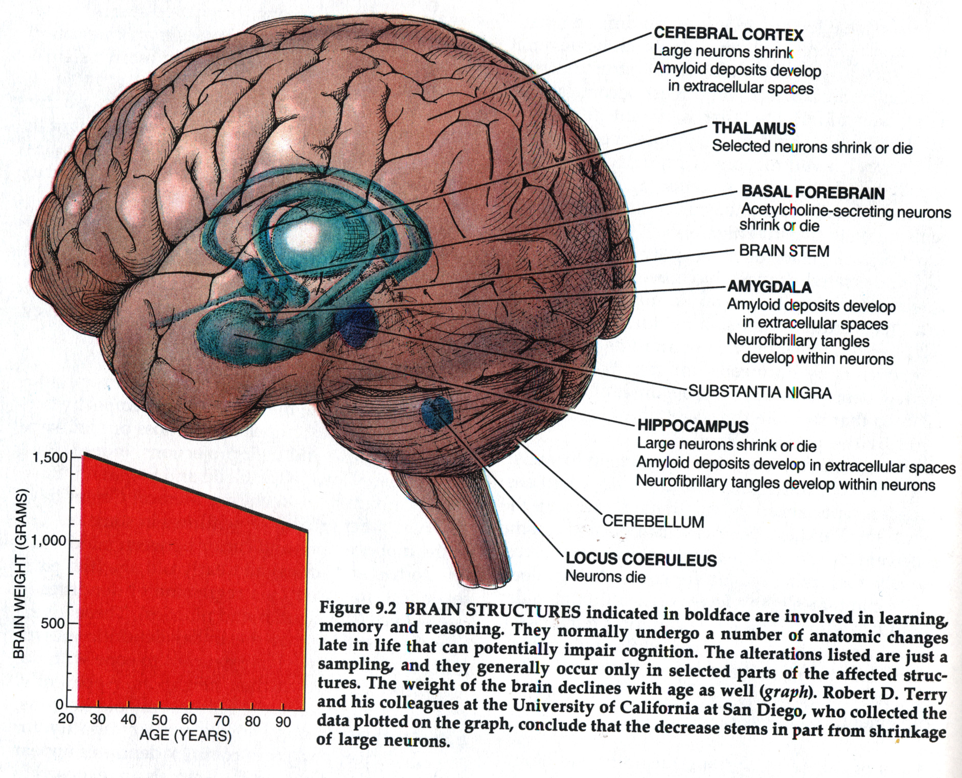
NORMAL BRAIN ATROPHY WITH AGE

Slide 26
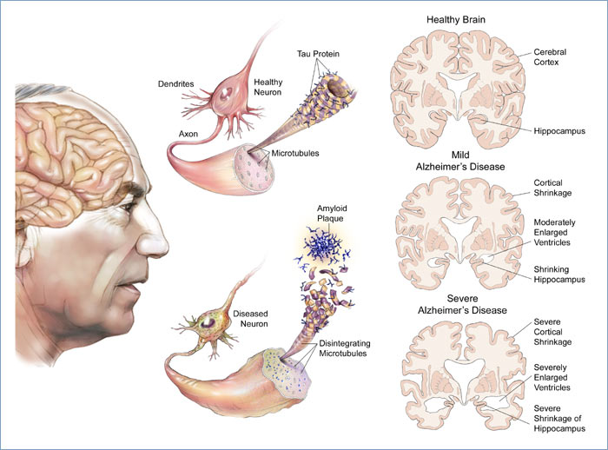
Alzheimer’s Disease: progressive loss of neurons
Short-term memory goes first
Than more severe shrinkage of brain tissue

Slide 27
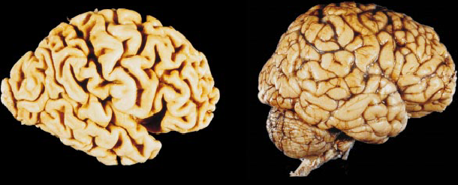
Brain Atrophy (Shrinkage)
Alzheimer’s Brain
Normal Brain

Slide 28
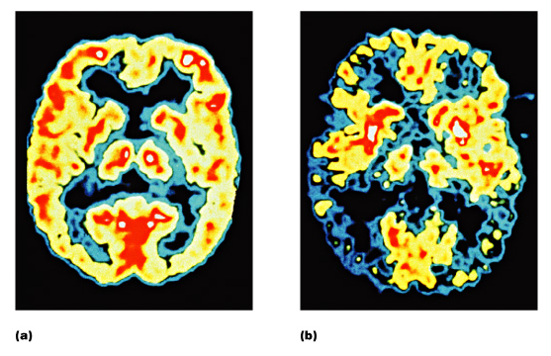
Changes in Brain Activity
Normal
Alzheimer’s
Brain activity decreases in AD patients

Slide 29
What are the Behavioral Changes in AD Patients?
AD begins slowly
1st – mild forgetfulness
  Trouble remembering events, activities, names
2nd – More serious symptoms of disease
  Interferes with daily life
  Cannot recognize people or familiar places
3rd – anxiety, aggression or wander away from home
4th – Confined to nursing home and death

Slide 30
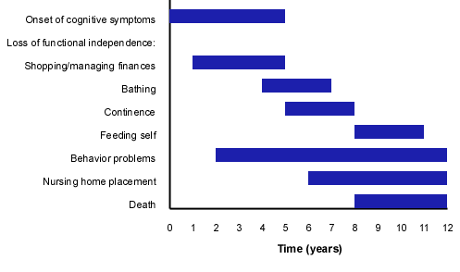
AD Patients: Progressive Degeneration

Slide 31
How is AD Diagnosed?
Only definitive way is to perform post-mortem autopsy of brain tissue
  See plaques and tangles in the brain regions affected
Psychological Test:
  90% accurate “probable” AD
  Tests of memory, problem solving, attention, counting, language
  Brain scans are becoming more accurate but still not 100%
  There is a large-scale effort to identify simple, non-invasive diagnostic test for AD

Slide 32
What Causes AD?
No single cause identified
Age most important known risk
Genetics may play some role
  Early-onset familial AD
  More common is late onset
  ApoE gene: higher chance of getting AD
Presence of (1) beta-amyloid plaques and (2) neurofibrillary tangles (NFTs)
  Normal processing of certain proteins goes terribly wrong

Slide 33
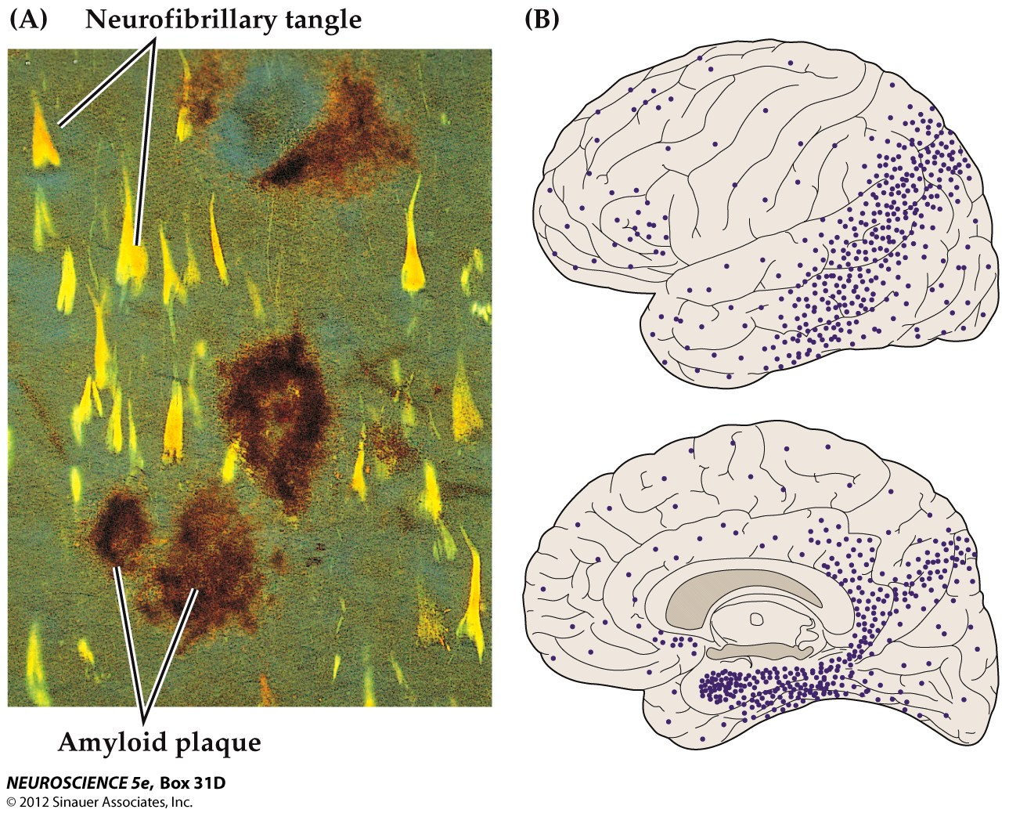
Pathological Changes Contribute to AD

Slide 34
Normal Neuron
AD Neuron
Aberrant neural activity
Dysfunction and loss of synapses
Degeneration of specific neuronal populations

Slide 35
Alzheimer's disease: Summary
Diagnosis
  Positive only by autopsy
  Initially, diagnosis may be made by ruling out other brain diseases
Treatment
  Supportive, no known cure
  Focused on safety, maintaining nutrition, hydration, personal hygiene
  Emotional support for family and caregivers
Notes:
35

