Slide 1
Chapter 19
Genetic and Developmental Diseases and Disorders
Notes:
1

Slide 2
Learning Objectives
Define the terminology common to genetic and developmental disorders.
Identify the important signs and symptoms associated with genetic and developmental disorders.
Describe the common diagnostics used to determine the type and cause of genetic or developmental disorders.
Gain knowledge of some common genetic and developmental disorders.

Slide 3
Basic Genetics of Cells
In the nucleus of almost all human cells are 46 chromosomes – 23 pairs
These cells are called somatic cells and reproduce through cell division throughout your lifetime
Use also have germ cells (sex cells) that are produced in a process called meiosis
  Haploid cells carrying 23 chromosomes or half the number of chromosomes
Notes:
3

Slide 4
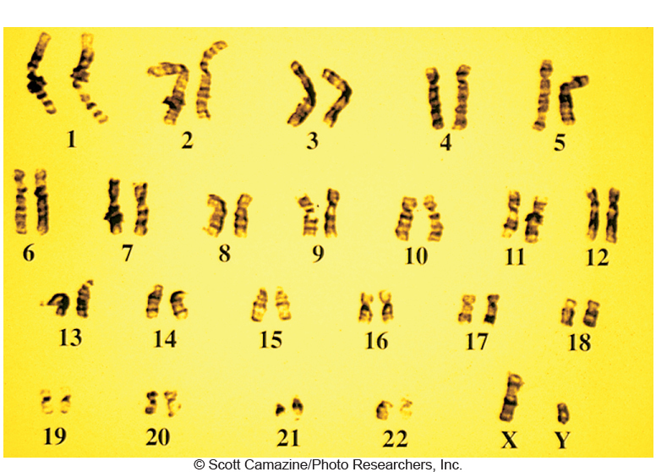
Human Male Karyotype
Karyotype of a human male (46 total chromosomes)

Slide 5
Human Female Karyotype
Karyotype of a human female (46 total chromosomes)

Slide 6
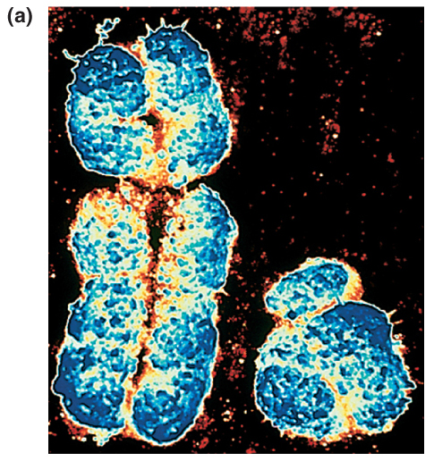
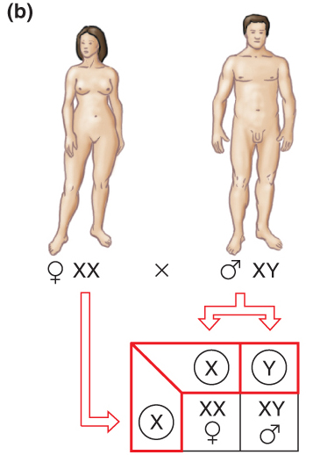
The X and Y chromosomes determine sex in humans
Children receive an X chromosome from their mother, but either an X or Y chromosome from their father
Results in 1:1 ratio of females-to-males

Slide 7
Fertilization = Correct Chromosome Number
Sperm = 22 + X or Y (23)
Egg = 22 + X (23)
Zygote = 23 + 23 = 46 chromosomes total!!
Female X germ cell is much larger than male Y cell and carries more genetic information
Chromosomes are made of deoxyribonucleic acid (DNA) and in a specific order; chromosomes can genes that code for information
Chromosomes (one from each parent) pair up during fertilization; these paired genes are alleles
Notes:
7

Slide 8
Genetic Diseases
Abnormalities can be due to:
  Chromosomal disorder
  Genetic disorder
  Environmental factors
  Combination of above
Individuals acquire abnormal genes in two ways:
  Mutation of gene during meiosis
  Passage of abnormal gene from parents (heredity)
Notes:
8

Slide 9
Diagnostic Tests for Genetic Diseases
Fetal ultrasound
  Detects malformations
Amniotic fluid (Amniocentesis)
  Reveals genetic and chromosomal disorders
Maternal blood
  Reveals abnormal fetal substances
Genetic Testing of Fetal DNA
  Examine the genetic code of certain genes
  Coming soon = All Genes!!
Notes:
9

Slide 10
Family History and Genetic Diseases
Diseases that occur at an earlier age than expected
  10 to 20 years before most people get the disease
Disease in more than one close relative
Disease that does not usually affect a certain gender (e.g. breast cancer in a male uncommon)
Certain combinations of diseases within a family (e.g. breast and ovarian cancer, or heart disease and diabetes)

Slide 11
Chromosomal Abnormalities
This results when the egg or the sperm do not have the correct number of chromosomes
  46 is the normal chromosome number for humans
    44 autosomes plus 2 sex chromosomes.
Usually results in lethality of the fertilized egg and developing embryo or fetus.
In some case the baby is born with abnormal chromosome number.
Can result in mild to severe genetic disorders

Slide 12

Chromosomal Abnormalities
Down Syndrome
Patau Syndrome

Slide 13

Down Syndrome
Down Syndrome
Trisomy 21 (3 copies of
Chromosome 21)

Slide 14
Down Syndrome
Also called trisomy 21 – a condition of having 3 chromosomes instead of the normal 2 in the 21st position of the chromosome chain
Symptoms:
  Mild to severe mental disability
  Flat nasal bridge Low-set ears
  Slanted eyes Epicanthus
  Thick, protruding tongue
  Abnormal extremities
  Organ defects
Treatment:
  Highly individualized to maximize mental and physical abilities
Notes:
14

Slide 15
Patau’s Syndrome
Patau’s Syndrome
Trisomy 13 (3 copies of
Chromosome 13)

Slide 16
Sex-Chromosome Abnormalities
Klinefelter’s syndrome
  Affects males; do not develop secondary sex characteristics
  Cause:
    Chromosomal disorder
    Affected males have extra X chromosome
  Symptoms:
    Not diagnosed until puberty due to abnormal male sexual development
    Sterility, abnormally small penis and testes
    General appearance of a eunuch – tall, slender body and long legs
  Treatment:
    Testosterone treatment and psychological counseling
Notes:
16

Slide 17
Sex Chromosome Abnormalities
Turner’s syndrome
  Affects females; ovaries are abnormal or absent
  Cause:
    Chromosomal disorder
    Females have only one X chromosome
      Rather than two XX chromosomes
  Symptoms:
    Failure to develop normal secondary sex characteristics
  Treatment:
    Reduce growth with hormones and estrogen therapy
Notes:
17

Slide 18
Basic Genetics: Human Genes
Each gene in an allele can be dominant or recessive
Alleles are just a different version of a gene
Homozygous – matched alleles such as YY or GG
Heterozygous – unmatched alleles such as YG
So in this case each child gets Y gene from one parent and G gene from the other parent
Notes:
18

Slide 19
Genetic disorders are passed to offspring in four ways:
  Autosomal dominant
    Only need one copy from a parent
  Autosomal recessive
    Need a copy from mother and father
  Sex-linked recessive
    Gene mutation located on the X chromosome
    Can get gene from mother or father (males get it from mother)
  Complex genetic disorders
    Multiple genetic factors lead to disease or disorder
Notes:
19

Slide 20
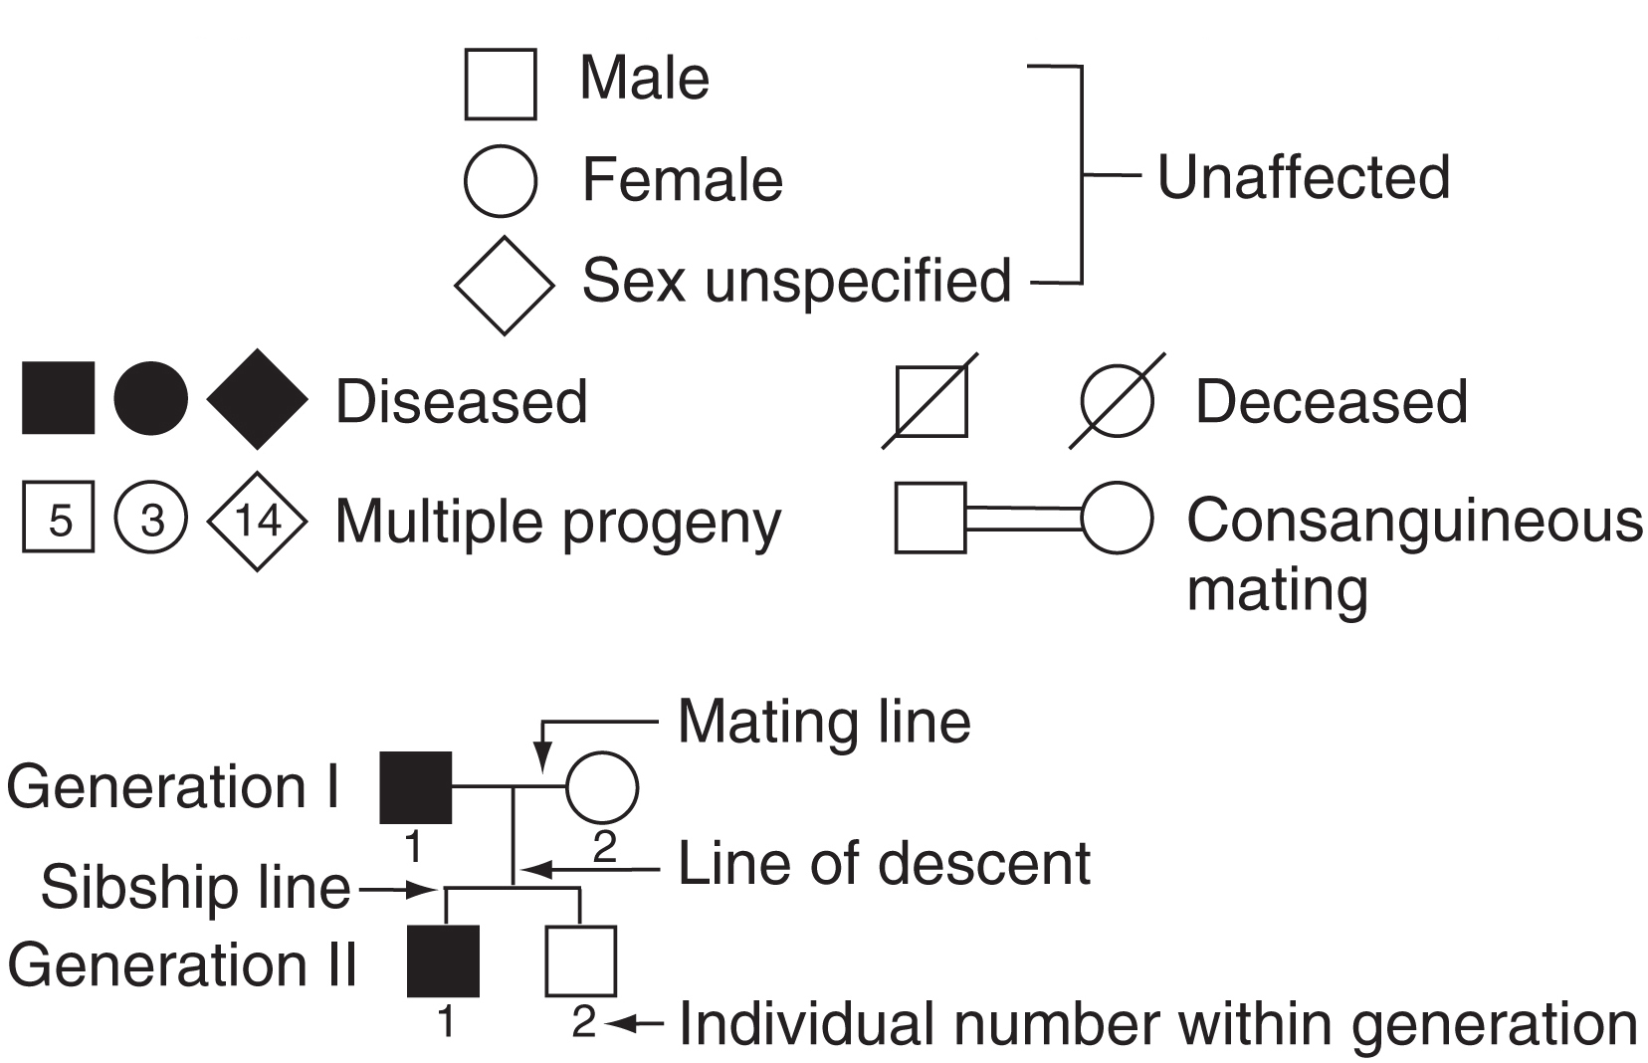
Pedigree Analysis
Pedigrees are used to map and follow mutations in families

Slide 21
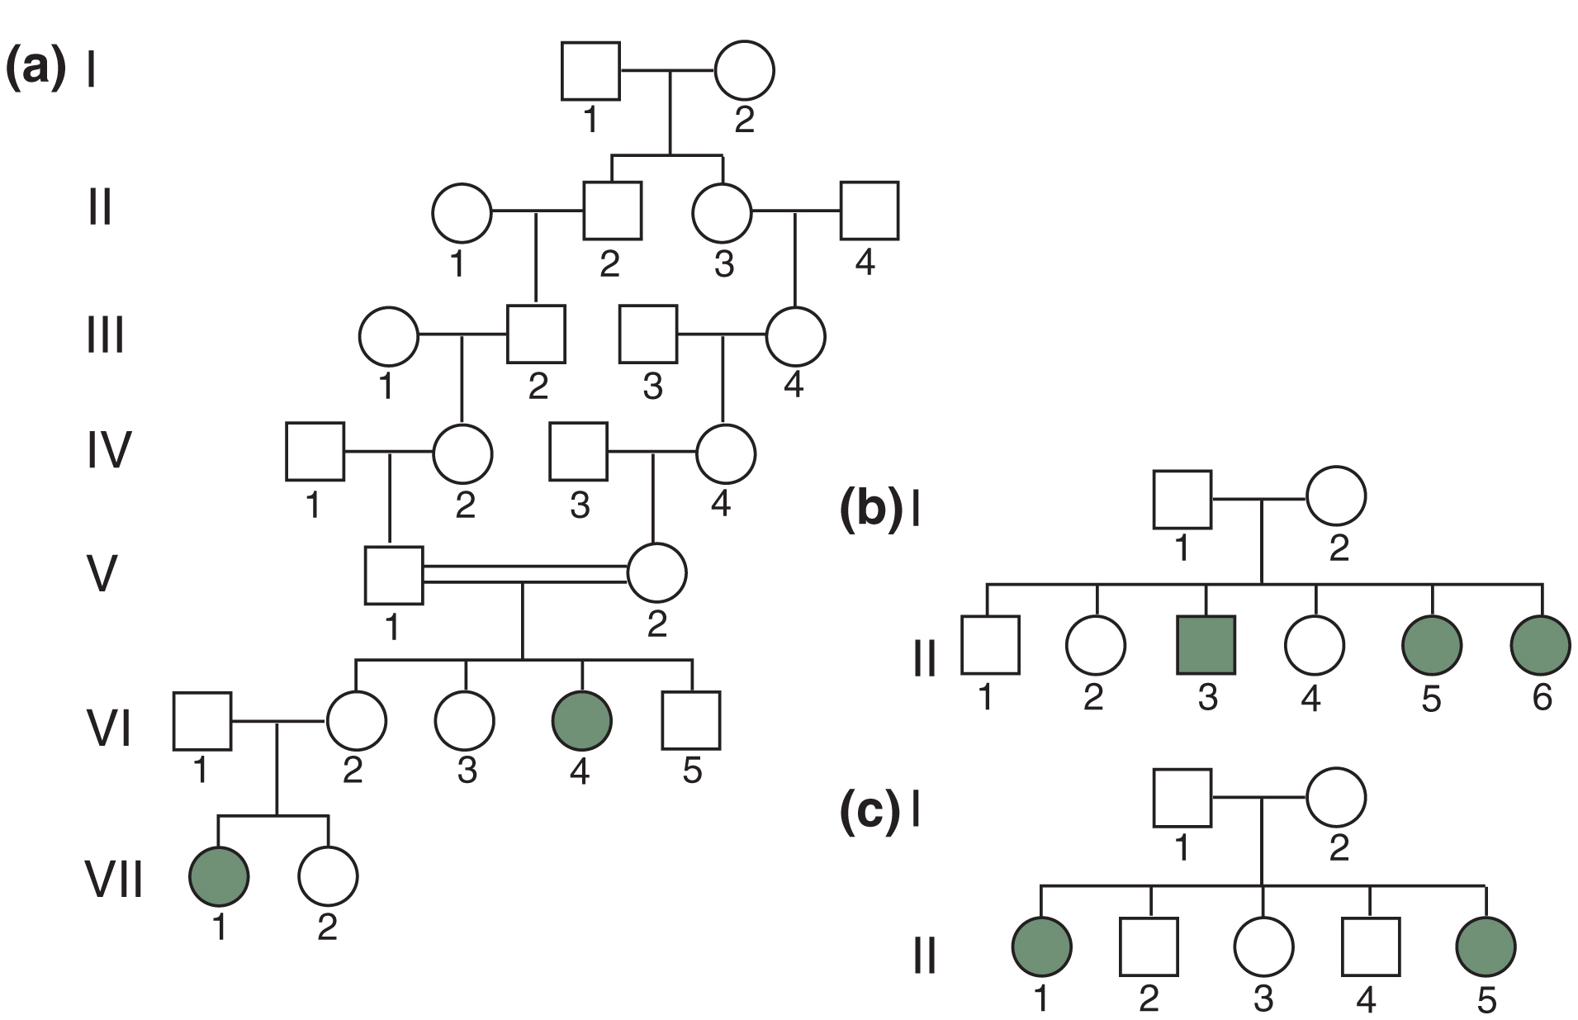

Slide 22
Human Genetic Diseases: Some specific examples
Huntington Disease – dominant
Cystic Fibrosis - recessive
Tay-Sach’s Disease – recessive
Sickle-Cell Anemia – recessive

Slide 23
Dominant Genetic Disorder
Huntington’s disease
  Genetic defect of chromosome 4
  Cause:
    Genetic – if one parent has disorder, 50% chance in offspring
  Symptoms:
    Behavioral changes
    Unsteady gait
    Increasing dementia
  Treatment:
    No cure
    Medications reduce symptoms

Slide 24
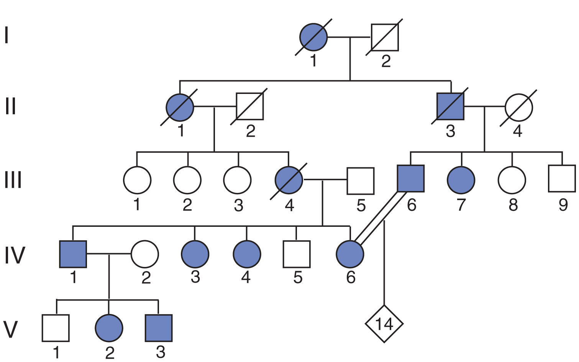
Pedigree for Huntington’s Disease: Dominant Genetic Disorder
Aa
aa
Presence of Huntington’s Disease Tends to not skip generations. Why?

Slide 25
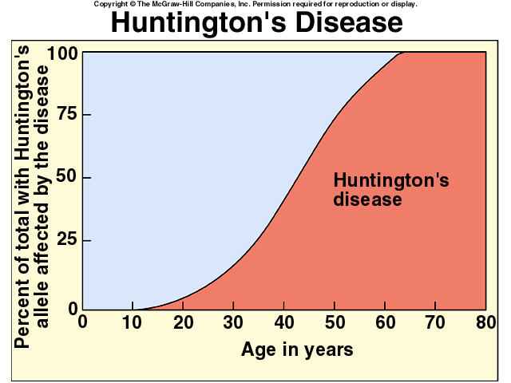
Dominant mutation (only need one mutant copy)
Has persist in population because afflicted people die after reproductive age

Slide 26
Common Recessive Diseases
Disease | Effect | Incidence of Disease
Thallassemia (chromosome 16 or 11) | Reduced amounts of hemoglobin; anemia, bone, and spleen enlargement | 1/10 in parts of Italy
Sickle-cell anemia (chromosome 11) | Abnormal hemoglobin; sickle-shaped red cells, anemia, blocked circulation; increased resistance to malaria | 1/625 African-Americans
Cystic fibrosis (chromosome 7) | Defective cell membrane protein; excessive mucus production; digestive and respiratory failure | 1/2000 Caucasians
Tay-Sachs disease (chromosome 15) | Missing enzyme; buildup of fatty deposit in brain; buildup disrupts mental development | 1/3000 Eastern European Jews
Phenylketonuria (PKU) (chromosome 12) | Missing enzyme; mental deficiency | 1/10,000 Caucasians
Table 2.1

Slide 27
Recessive Genetic Disorders
Aa
aa
aa

Slide 28
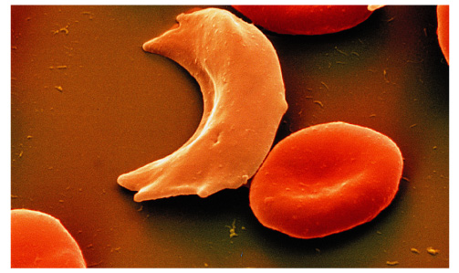
Recessive Genetic Disorders
Sickle cell anemia
  Chronic hereditary form of anemia
  Due to mutation in the Beta-Globin Gene
  Predominantly affects black population
Notes:
28

Slide 29
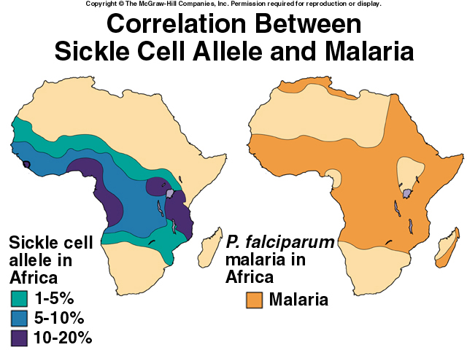
Is it advantageous to have mutant copy of the hemoglobin allele?

Slide 30
Recessive Genetic Disorders
Cystic Fibrosis
  Cause:
    Hereditary recessive disorder
    Get one bad mutated copy of the CFTR gene from mother and other from father (need 2 mutated genes for disease)
  Symptoms:
    Affects all exocrine glands (primarily lungs) leading to viscous secretions
  Treatment:
    Postural drainage
    Chest-clapping
    Antibiotics
    Bronchodilators
    Expectorants
    Oxygen
Notes:
30

Slide 31
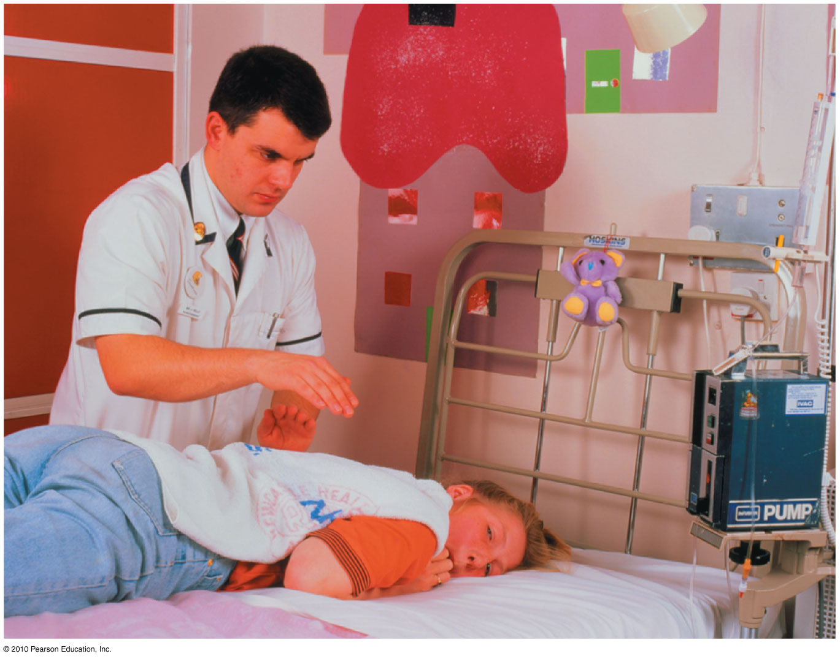
Chest-Clapping of Boy with CF

Slide 32
Tay-Sachs Disease
High incidence in Ashkenazi Jews (1 in 3600)
Defective gene codes for an enzyme in brain cells
  Gene called HEXA and codes for enzyme called Hex-A
  Lack of this enzyme leads to accumulation a fat molecule in the brain called gangliosides in infant brains
  Many clinical symptoms of disease
    Neurological problems
    Brain degeneration
    Eventual leads to death usually before age 5

Slide 33
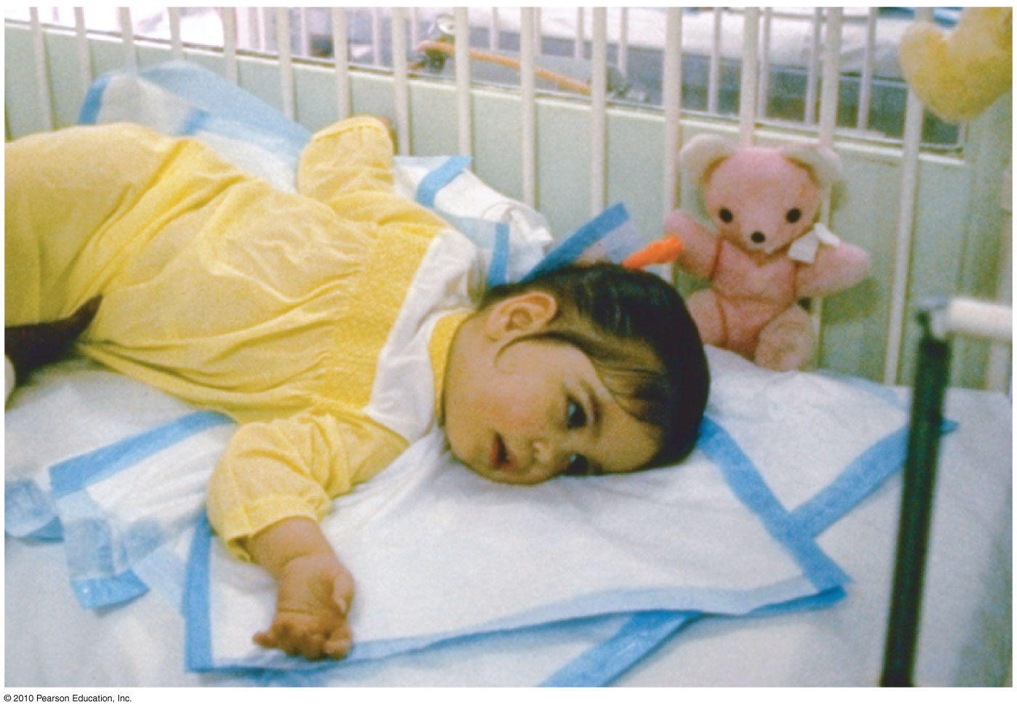
Young child with Tay-Sachs Disease

Slide 34
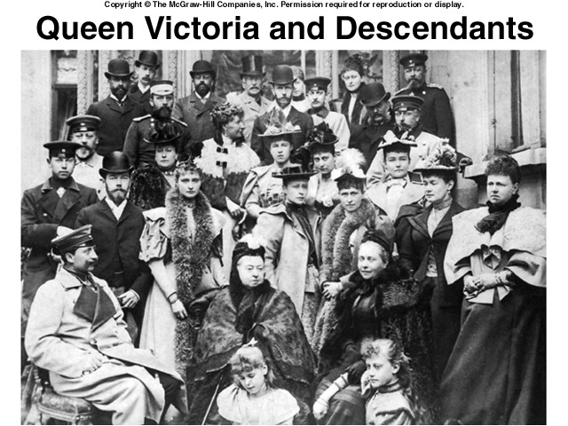
Sex-Linked Genetic Diseases

Slide 35
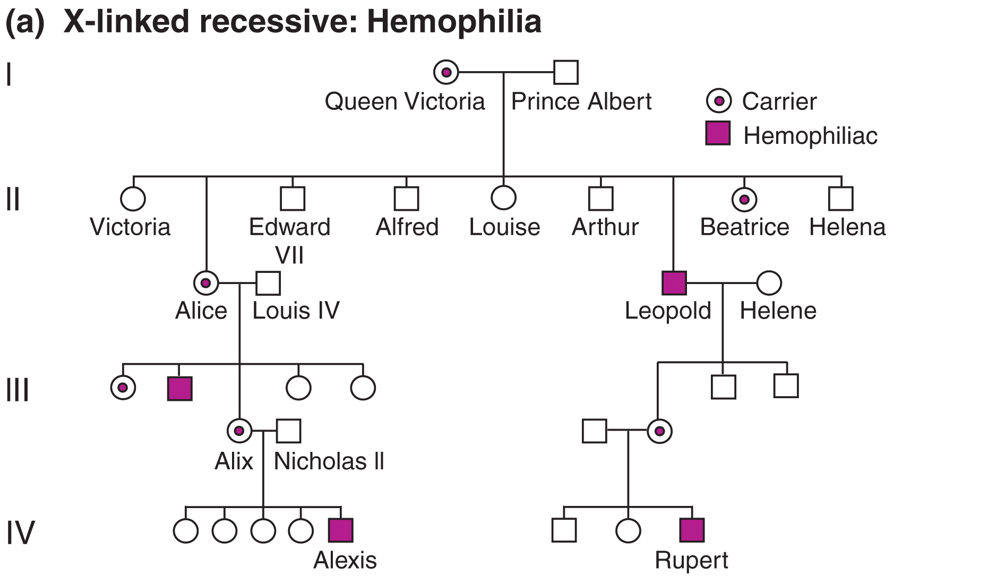
An example of a pedigree for an sex-linked recessive trait: Hemophilia

Slide 36
Muscular dystrophy (MD): Sex-Linked
Muscular dystrophy (MD)
  Genetic degeneration or weakening of muscles
  Duchenne’s MD
    Most common type
  Cause:
    Sex-linked disorder passes mother to son
  Symptoms:
    Onset between 2 and 5 years of age
    Waddling gait, toe walking, lordosis, Gower’s maneuver
  Treatment:
    No cure
    Physical therapy, orthopedic devices, exercise helpful
Notes:
36

Slide 37
More Complex Genetic Disorders
Autism
  Developmental disorder characterized by difficulty communicating and in forming relationships
  Cause:
    Unknown but likely to due combination of multiple genes and environmental/developmental factors
  Symptoms:
    Blank facial expression
    Involved with self – inaccessible to others
  Treatment
    Behavioral therapy
    Depends on severity and symptoms present
Notes:
37

