Slide 1
AIDS – What happens when the immune system fails?

Slide 2
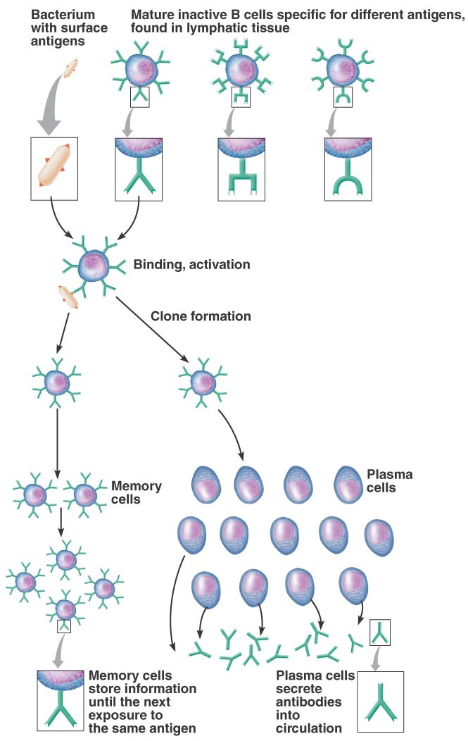
B Cells produce antibodies
Each antibody specific for a specific antigen
Your body produces 1000s of different antibodies
Termed Humoral Immunity

Slide 3
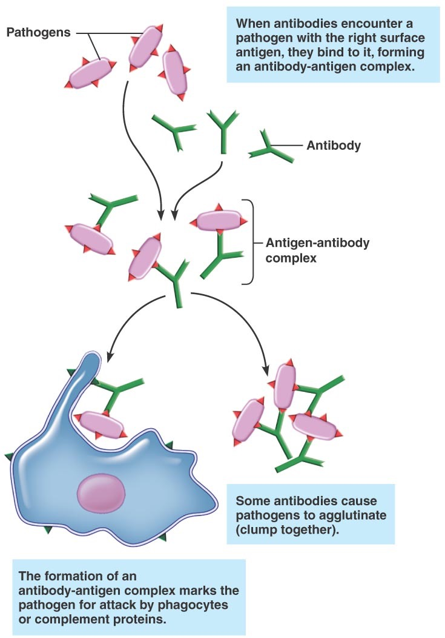
Antibodies

Slide 4
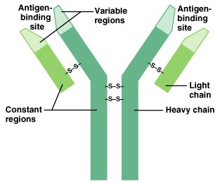
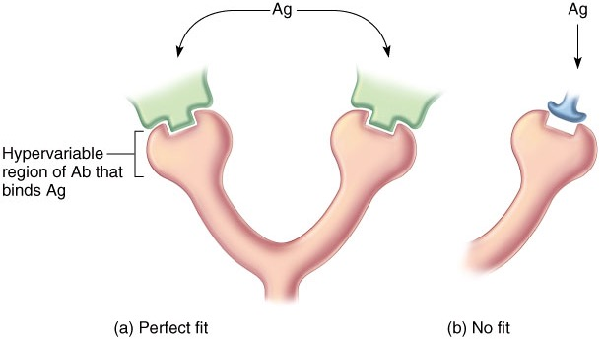
Antibodies: Lock and Key Model
-- Antibodies have hypervariable regions that bind
antigens
-- This variability arises from “reshuffling” of the
genes encoding the antibody proteins

Slide 5
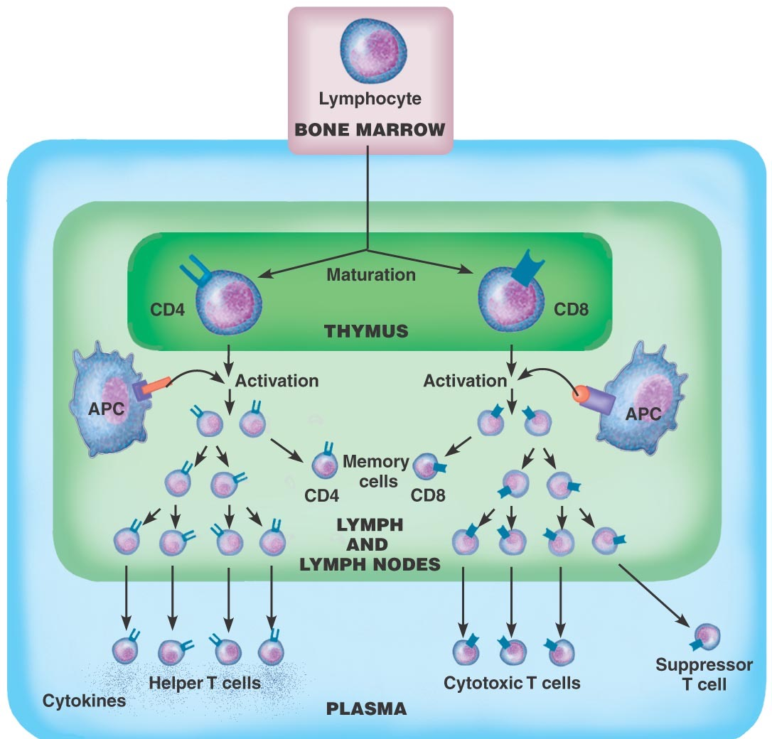
Cell-Mediated Immunity

Slide 6
Immune Deficiency Disorders
Inability of immune system to protect individual against disease
Congenital, genetic disorder or acquired
Notes:
6

Slide 7
Immune Deficiency Disorders
Acquired types may be due to:
  Bone marrow suppression from chemotherapy and radiation
  Medications given to organ transplant recipients
  Immunodeficiency
    E.g., acquired immunodeficiency syndrome (AIDS)
Notes:
7

Slide 8
Immune Deficiency Disorders
AIDS
  Human immunodeficiency virus (HIV)
  Eradicates individual’s lymphocytes
  Virus must enter body and bloodstream
  Virus is very fragile and easily killed
Notes:
8

Slide 9
Immune Deficiency Disorders
AIDS – Transmission of HIV
  Many misconceptions
  A person cannot get HIV from:
    Toilet seats
    Door knobs
    Furniture
    Water fountains
    Social kissing
    Coughing / sneezing
    Sharing utnesils
    Air – food – urine – feces – water
Notes:
9

Slide 10
Immune Deficiency Disorders
AIDS primarily spread three ways:
  Sexual intercourse
  Sharing of hypodermic needles
  In utero from infected mother to unborn baby
Notes:
10

Slide 11
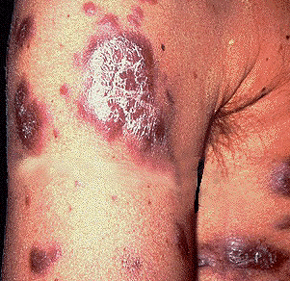
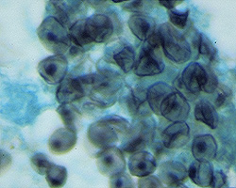
AIDS: The Beginning…
-- December, 1980: San Francisco and New York
Seemingly healthy men were coming down with rare
diseases, such as Pneumocystis pneumonia and
Kaposi’s sarcoma
-- Incidence of both diseases restricted to gay men
-- Also found in Haitian immigrants

Slide 12
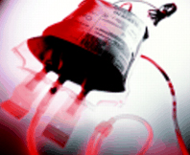
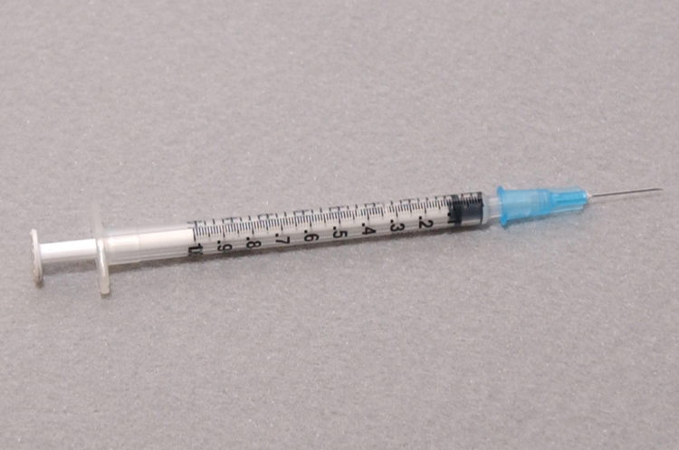
The Beginning…
-- By mid-1982, the syndrome was identified in
hemophiliacs and IV drug users.
-- All risk factors had the exchange of bodily fluids
in common
-- Affected individuals had reduced T cell counts

Slide 13
Naming the Malady
-- Called “4 H disease”: Homosexuals, Haitians,
Heroin users, Hemophiliacs
-- GRID: Gay-Related Immune Deficiency
-- “Gay Plague”; “A judgment of God”; “we do reap it in our flesh when we violate the laws of God”
-- Once it was shown in heterosexual individuals and children, a more benign name was chosen: AIDS (Acquired Immune Deficiency Syndrome)

Slide 14
The Beginning…
-- In early 1983, the first heterosexual cases were identified: 2 women who were partners of IV drug users
-- 1983: 3,068 US cases; 48% had died (not reportable
to CDC in all states until 1983)
-- Africans identified with the disease: mostly heterosexuals who did not use IV drugs
-- Supported the idea that AIDS was primarily a STD
-- Also determined that risk for AIDS increases with number of sex partners and with certain sexual behaviors

Slide 15
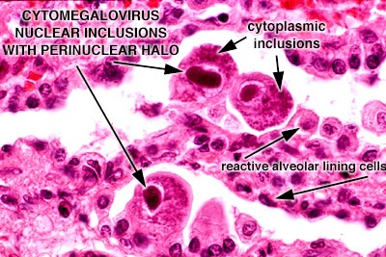
Big Question: What Causes AIDS?
-- Mutant Cytomegalovirus?
-- “Poppers”?
-- Could having numerous STDs overwhelm the
immune system?
-- Sperm in the male bowel?
-- Infectious disease?
-- Finally, in 1983, French and American researchers
identified Human Immunodeficiency Virus (HIV) as
a cause of the syndrome
CMV

Slide 16
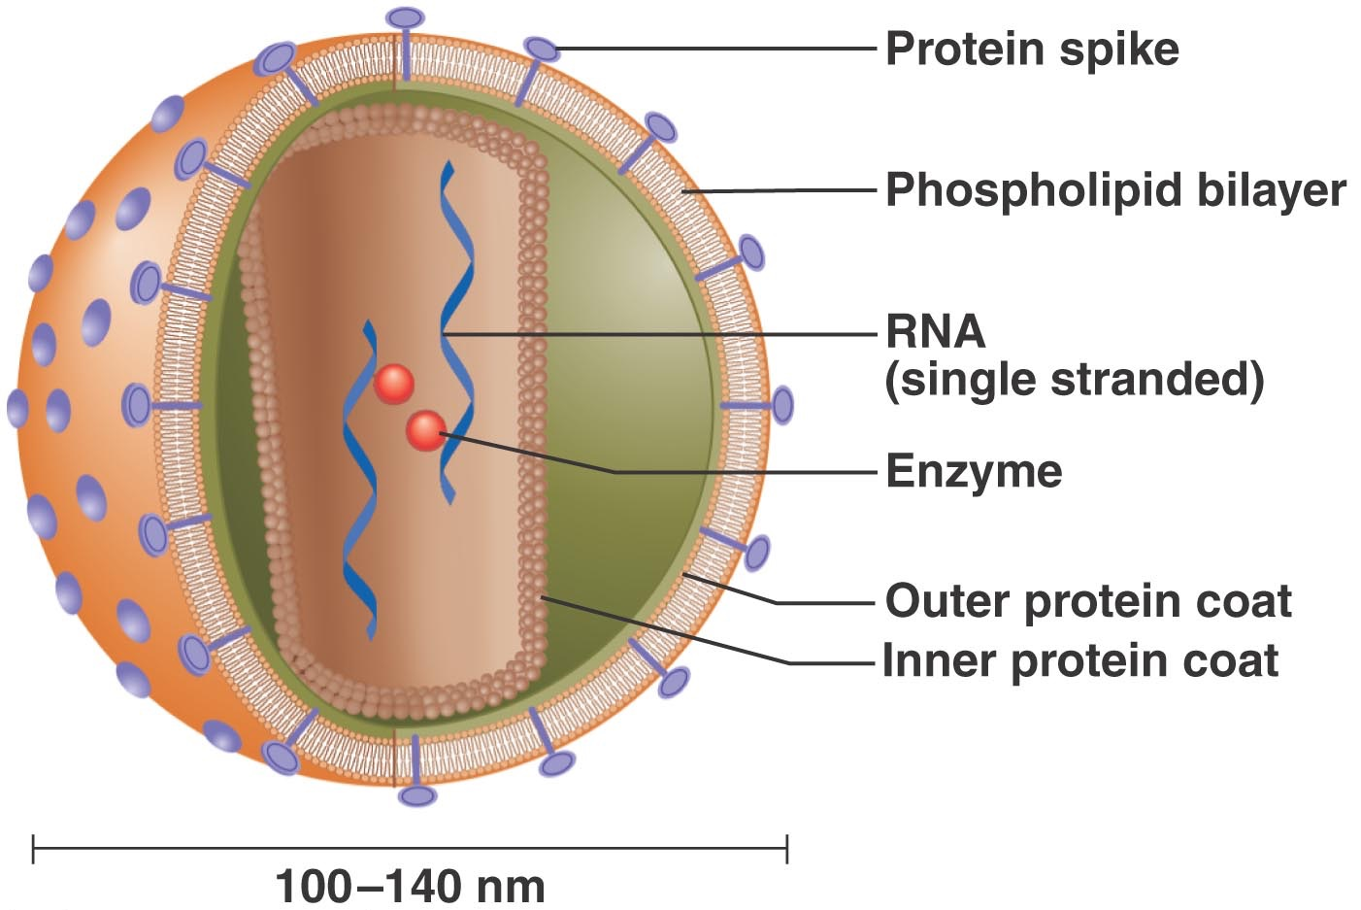
Structure of HIV

Slide 17
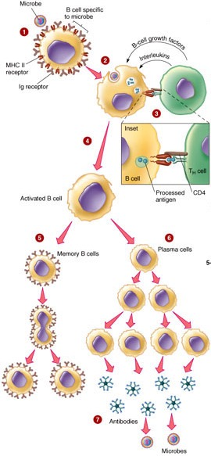
How Does HIV Cause
AIDS?
-- HIV attacks mainly Helper T cells,
blunting the immune response

Slide 18
Immune Deficiency Disorders
HIV Stages
  Acute Infection
  Clinical Latency
  Early-Stage AIDS
  Middle-Stage AIDS
  Late-Stage AIDS
Notes:
18

Slide 19
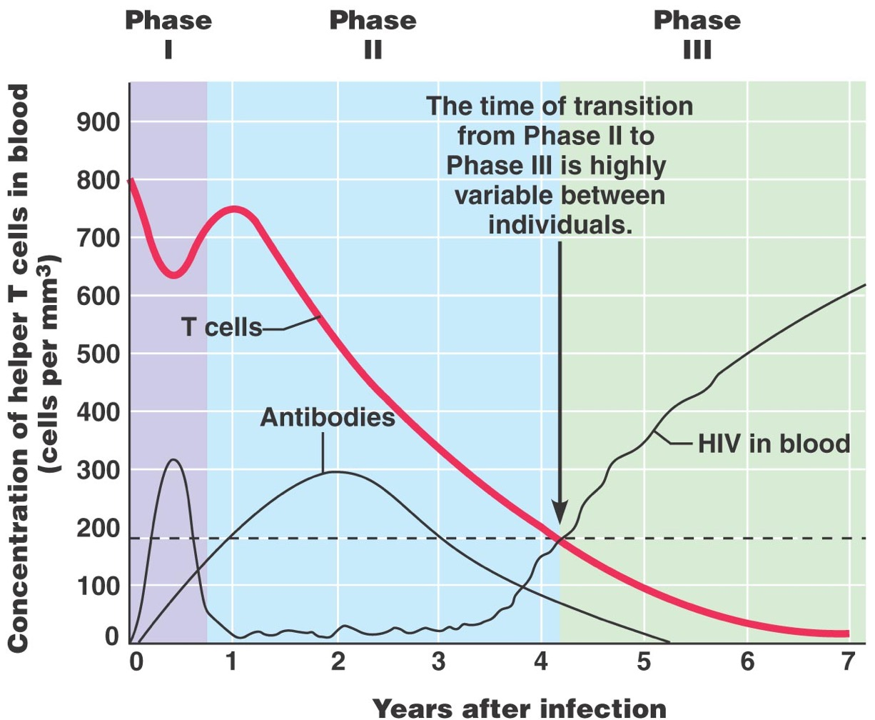

Slide 20
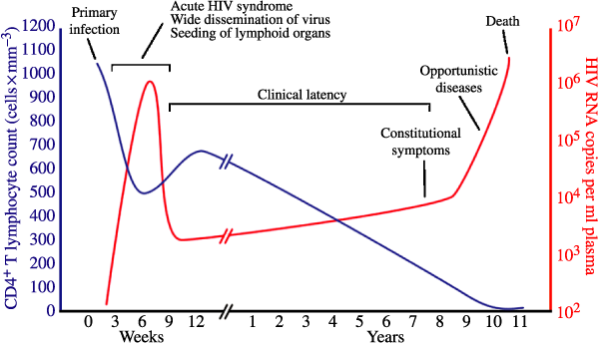
The first postmodern pandemic: 25 years of HIV/ AIDS
Journal of Internal Medicine
Volume 263, Issue 3, pages 218-243, 17 JAN 2008 DOI: 10.1111/j.1365-2796.2007.01910.x
http://onlinelibrary.wiley.com/doi/10.1111/j.1365-2796.2007.01910.x/full#f2
Notes:
Typical course of HIV infection.
IF THIS IMAGE HAS BEEN PROVIDED BY OR IS OWNED BY A THIRD PARTY, AS INDICATED IN THE CAPTION LINE, THEN FURTHER PERMISSION MAY BE NEEDED BEFORE ANY FURTHER USE. PLEASE CONTACT WILEY'S PERMISSIONS DEPARTMENT ON PERMISSIONS@WILEY.COM OR USE THE RIGHTSLINK SERVICE BY CLICKING ON THE 'REQUEST PERMISSIONS' LINK ACCOMPANYING THIS ARTICLE. WILEY OR AUTHOR OWNED IMAGES MAY BE USED FOR NON-COMMERCIAL PURPOSES, SUBJECT TO PROPER CITATION OF THE ARTICLE, AUTHOR, AND PUBLISHER.

Slide 21
Immune Deficiency Disorders
Late-Stage AIDS
  T-cell count drops below 200 cells per microliter
  Treatment with Anti-Retroviral Therapy
  Prevention – Avoid the HIV virus
Notes:
21

Slide 22
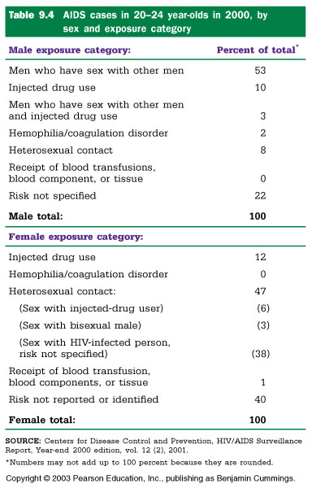

Slide 23
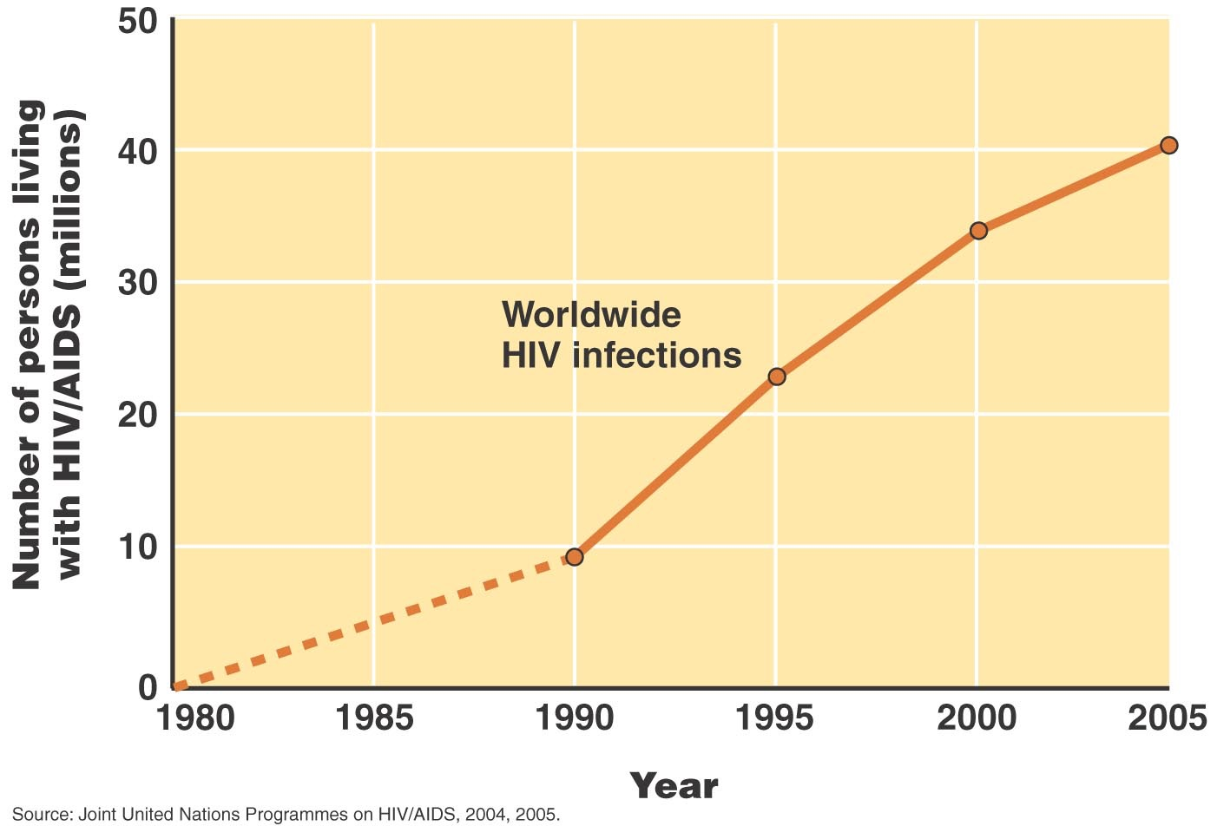

Slide 24
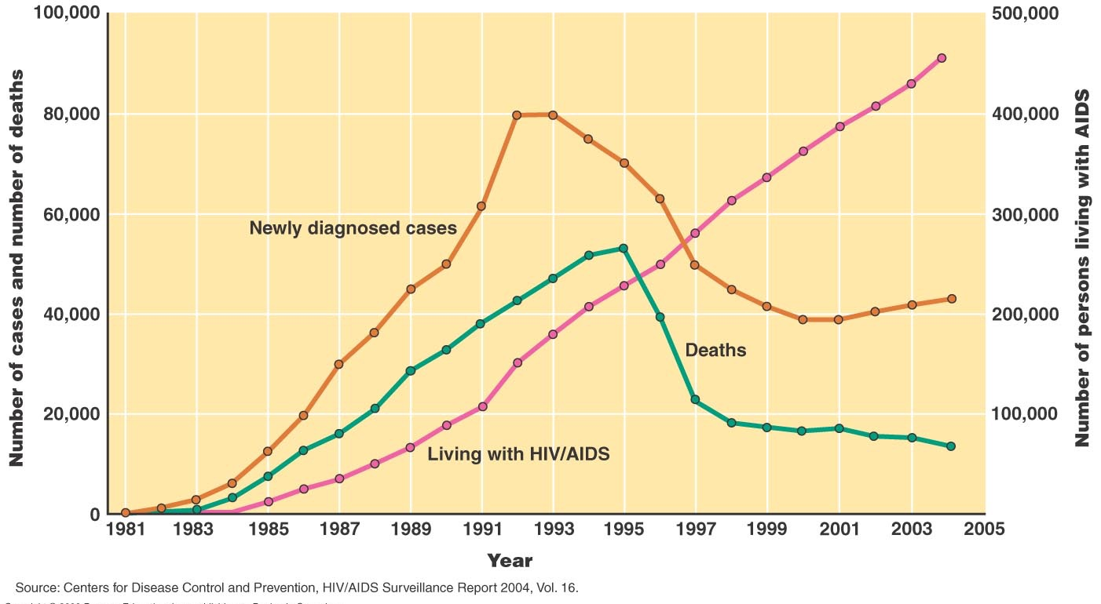

Slide 26
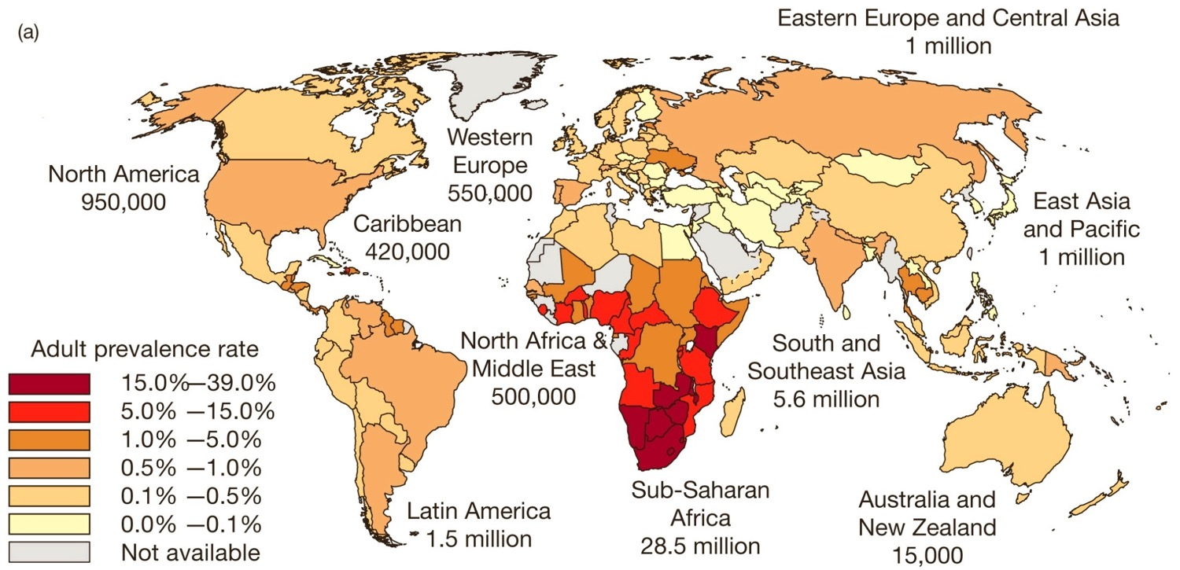
AIDS Pandemic: 2005

Slide 32
Rare Diseases
Severe combined immunodeficiency disease (SCID)
  Group of inherited disorders that cause partial or complete dysfunction of immune system (i.e. Apex Disease)
Notes:
32

Slide 33
Effects of Aging
Degenerated thymus gland
Changed function of antibodies
Notes:
33

