Slide 1
Immune System and Disorders- Chapter 5

Slide 2
Learning Objectives
Define the terminology common to the immune system and the disorders of the system.
Discuss the basic anatomy and physiology of the immune system.
Identify the important signs and symptoms associated with common immune system disorders.
Describe the common diagnostics used to determine type, cause, or both of an immune system disorder.

Slide 3
Anatomy and Physiology of the Immune System
Organs:
  Thymus gland
  Bone marrow
  Lymph nodes
  Spleen
  Liver
  Tonsils
Open textbook BC
Notes:
3

Slide 4
Anatomy and Physiology
Immune Response
  Specific
    Antigen and antibody reaction
  Nonspecific
    Inflammation
    Phagocytosis
    Physical barriers (skin & mucous membranes)
    Chemical barriers (acids & other secretions)
    First line of defense
Notes:
4

Slide 5
Immune Response

Slide 6
Blood Cells of Immune System

Slide 7
Types of Immune Disorders
Hypersensitivity
  Examples: allergies, asthma
Autoimmune
  Examples: Multiple Sclerosis, Lupus, Rheumatoid Arthritis
Isoimmune
  Rh factor antibodies
Immune Deficiency
  HIV (AIDS)

Slide 8
Common Signs and Symptoms
Vary depending on organ involved
Related to factors, such as the following:
  Immunodeficient
    Lack of immunity
  Autoimmune
    Immunity against self
  Isoimmune
    Immunity against other humans
Notes:
8

Slide 9
Diagnostic Testing
Skin tests
Desensitization
Blood count
Coombs test
Antinuclear antibody (ANA)
Rheumatoid factor (RF)
Notes:
9

Slide 10
Types of Immune Disorders
Hypersensitivity
  Examples: allergies, asthma
Autoimmune
  Examples: Multiple Sclerosis, Lupus, Rheumatoid Arthritis
Isoimmune
  Rh factor antibodies
Immune Deficiency
  HIV (AIDS)

Slide 11
Hypersensitivity Disorders
Allergies
  E.g., hay fever, asthma
  Common reactions:
    Urticaria
    Contact dermatitis
  Symptoms:
    Elevated eosinophil count
    Redness, heat, swelling, and itching
    Runny nose, coughing, sneezing, wheezing, and nasal congestion
Hives or Urticaria
Sneezing
Notes:
11

Slide 12
Hypersensitivity Disorders: Hay Fever
Reaction to allergen in mucous membranes of nose and upper respiratory tract
Symptoms:
  Sneezing
  Watery eyes
  Runny nose
  Itching
  Causes of seasonal:
    Tree pollen
    Grasses
    Ragweed pollen
    Agricultural crops
  Causes of nonseasonal:
    Dust mites
    Pet dander
    Food allergies
Notes:
12

Slide 13
Hypersensitivity Disorders
Hay fever
  Treatment:
    Removal of allergen
    Air-conditioned environment
      Or move to different climate
    Antihistamines
    Allergy desensitization
Notes:
13

Slide 14
Hypersensitivity Disorders
Asthma
  Also known as bronchial asthma
  Symptoms:
    Extreme shortness of breath
    Difficulty breathing
    Wheezing
    Anxiety
    Cough
Asthma
  Treatment:
    Avoidance of causative allergens
    Desensitization
    Education
    Medication
  No cure
    But can be controlled
Notes:
14

Slide 15
Hypersensitivity Disorders
Anaphylaxis
  Severe allergic response to allergen
  Causes:
    Antibiotics
    Anesthetics
    Codeine
    Insulin
    Vaccines
    Foods
    Pollens
    Latex
Antibiotic
Latex Gloves
Honeybee
Jumping Jack Ant
Notes:
15

Slide 16
Hypersensitivity Disorders
Anaphylaxis
  May be mild to life-threatening
  Symptoms:
    Itching of throat, tongue, and scalp
    Edema of face and airways leading to difficulty breathing
  Treatment:
    Emergency tracheostomy
    Epinephrine
    Corticosteroids
    Antihistamines
Epinephrine Pen
Notes:
16

Slide 17
Hypersensitivity Disorders
Food allergies
  E.g., chocolate, shellfish, gluten, dairy, eggs
  Symptoms:
    Cramping
    Diarrhea
    Vomiting
Notes:
17

Slide 18
Types of Immune Disorders
Hypersensitivity
  Examples: allergies, asthma
Autoimmune
  Examples: Multiple Sclerosis, Lupus, Rheumatoid Arthritis
Isoimmune
  Rh factor antibodies
Immune Deficiency
  HIV (AIDS)

Slide 19
Autoimmune Disorders
Rheumatic fever
  Follows group A strep infection
  Occurs 1 to 4 weeks after strep infection
    Sudden or gradual onset
Notes:
19

Slide 20
Autoimmune Disorders
Rheumatoid arthritis
  Abnormal antibody that attacks or attaches to body’s own cells and tissues
  RF antibody in blood indicative of disease
  Classic sign:
    Ulnar deviation
  Affects fingers, wrists, elbows, feet, and knees most frequently
Notes:
20

Slide 21
Autoimmune Disorders
Rheumatoid arthritis
  Symptoms:
    Fever
    Malaise
    Joint pain
  Prevention:
    Accurate diagnosis of strep infections
    Surgical joint replacement
Rheumatoid arthritis
  Treatment:
    Anti-inflammatory medications
    Analgesics
    DMARDs
    Biological medications
    Exercise and rest routine
    Short-term corticosteroids
Notes:
21

Slide 22
Autoimmune Disorders: Lupus
Two types:
  Cutaneous
    Discoid
    Limited to skin
  Systemic
    Diffuse
    Affects multiple systems
Notes:
22

Slide 23
Autoimmune Disorders
Systemic lupus erythematosus (SLE)
  Chronic with remissions and exacerbations
  Symptoms:
    Butterfly rash
    Joint pain
    Fever
    Weight loss
Symptomatic treatment:
    Nonsteroidal anti-inflammatory drugs (NSAIDs)
    Antipyretics
    Analgesics
    Corticosteroids
Notes:
23

Slide 24
Autoimmune Disorders
Sceleroderma
  Hardening, thickening, and shrinking of connective tissues
    Including skin
  Periods of remission and exacerbation
  Symptoms:
    Joint contractures
    Raynaud’s phenomenon
    Thick, leather-like, shiny, taut skin
Treatment:
    No cure or treatment
    May use antibiotics, immunosuppressives, and anti-inflammatories
    May be beneficial to perform muscle stretching and strengthening exercises
Notes:
24

Slide 25
Types of Immune Disorders
Hypersensitivity
  Examples: allergies, asthma
Autoimmune
  Examples: Multiple Sclerosis, Lupus, Rheumatoid Arthritis
Isoimmune
  Rh factor antibodies
Immune Deficiency
  HIV (AIDS)

Slide 26
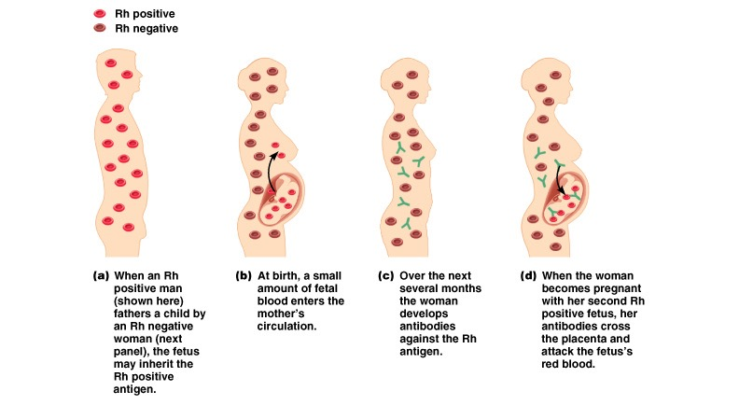
Developing Fetus Can Be Attacked

