Slide 1

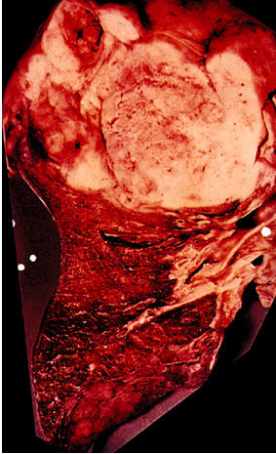
Lung Cancer

Slide 2
Some Scary Facts About Cancer
Estimated in 2019: 1.76 million Americans were diagnosed with cancer. Of those 606,880 will die of cancer
  the 2nd leading cause of death after heart disease
In Colorado and New Mexico estimated 26,800 and 9,460 new cases, respectively, in 2018
Biggest overall killer of those under age of 75
2nd leading disease killer of children and among 30somethings
Only 63% of cancer victims survive 5 years or more
More Americans will die of cancer in the next 14 months than all the casualties of every war the US has fought

Slide 4
At the end of this lecture you should know:
What is cancer?
What are the characteristics of cancer cells?
How does a normal cell become a cancer cell?
How do we diagnose and treat people with cancer?
What does the future hold for cancer treatment?

Slide 5
What is Cancer??
Cancer is a growth disorder of cells
Normal cell begins to grow in an uncontrolled manner
Result: mass of cells called a tumor that can expand rapidly in size
Tumors: more deadly when they become malignant and spread (metastasize)

Slide 6
Terminology Related to Neoplasms and Tumors
Neoplasm
  New growth
Tumor
  Swelling or neoplasm
Leukemia
  Malignant disease of bone marrow
Hematoma
  Bruise or contusion
Notes:
6

Slide 7
Classification of Neoplasms
Cancer
  General term for malignant tumor or neoplasm
Classified according to:
  Appearance and growth pattern
  Type of body tissue from which they arise
Notes:
7

Slide 8
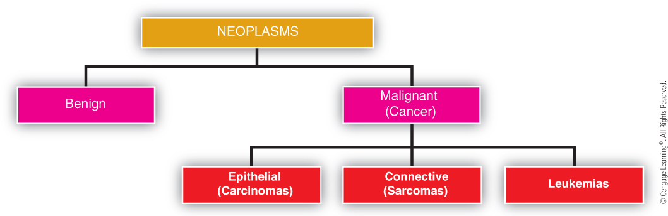
Classification of Neoplasms
Notes:
8

Slide 9
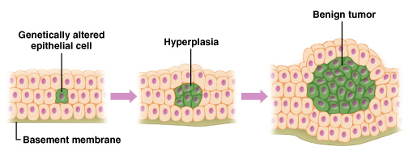
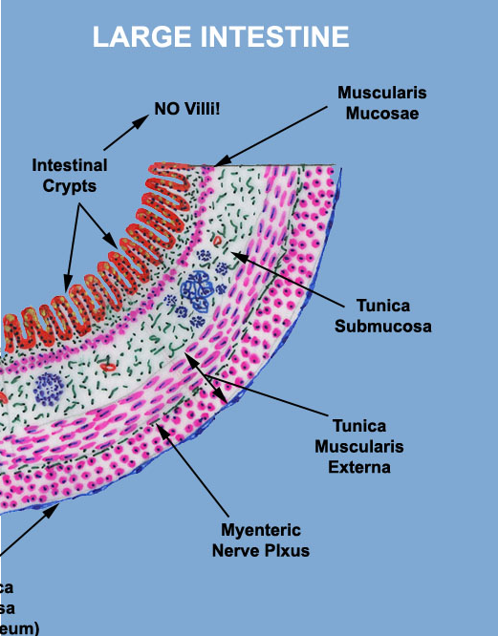
Benign Tumor: Abnormal Growth

Slide 10
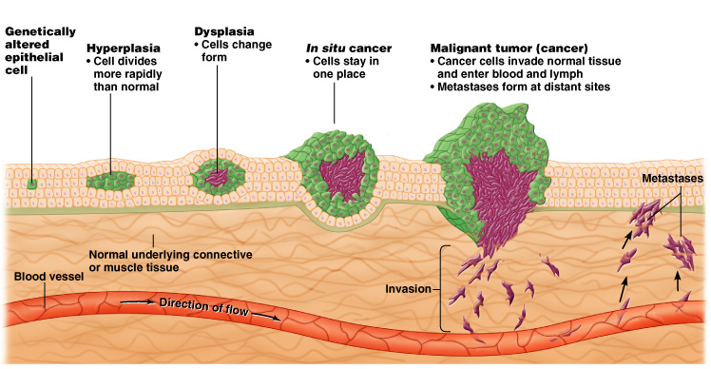
Malignant Tumor: Spread of Cancer Cells

Slide 11
Benign and Malignant Neoplasm Growth
Benign tumors
  Growth in particular area
    But not invasive or metastatic
  Encapsulated in capsule
  Easier to excise
  Limited growth potential
Malignant tumors
  Excessive, without regulation
  Without structure or function of normal cells
  Surface area not encapsulated
  Fast growing, outpace normal cells
Notes:
11

Slide 12
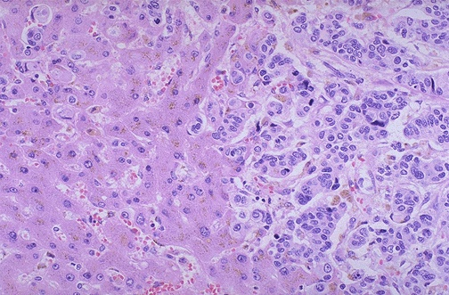
Normal Cells vs. Cancer Cells: Pathology
Metastatic cancer
cells
Normal
http://library.med.utah.edu/WebPath/LIVEHTML/LIVER035.html

Slide 13
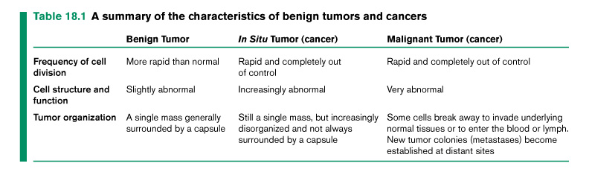
Benign vs. Malignant
Transition between from benign to malignant
  Can be variable in time course
  Process called carcinogenesis

Slide 14
What are Cancer Cells?
What makes a cell a “cancer” cell?
What are the major differences between a normal cell and a “cancer” cell?
What are oncogenes and tumor suppressor genes and how can they lead to cancer?

Slide 15
How do Cancer Cells Develop?
Mutated or Damaged Genes
  Oncogenes
  Tumor Suppressor Gene
Carcinogens
  Inherited susceptibility
  Types: viral, chemical, tobacco, radiation, dietary, and internal factors
  Immune System Interactions

Slide 16
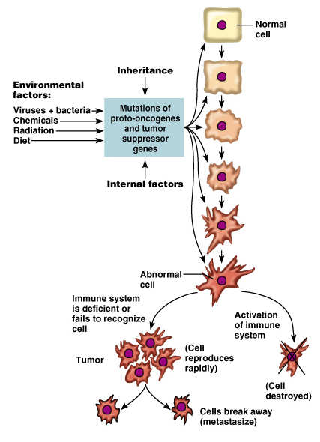
Two types of mutations:
Oncogenes
Tumor-suppressor Genes

Slide 17
Tumor Suppressors vs. Oncogenes
Tumor Suppressors: “Loss of Function” Mutations or loss of “brakes” on cell growth
  Examples: RB, p53, many others
Oncogenes: “Gain of Function” Mutations or “accelerated” cell growth
  Examples: Myc, Ras, many others

Slide 18
Genetics of Cancer
Inheritance of genetic mutations in tumor suppressor and oncogenes (or groups of genes) can predispose you to cancer
Some examples:
  p53
  BRCA1 and BRCA2 (breast cancer)
  RB - retinoblastoma
  Ptc – medulloblastoma
  ATM – breast cancer
  APC – colon cancer

Slide 19
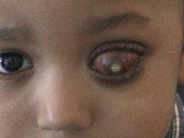
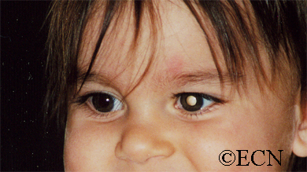
Retinoblastoma: Cancer of the Retina
Early Stage
Late Stage
Example of loss of cell growth inhibition (i.e. mutation in the tumor suppressor gene, RB)

Slide 20
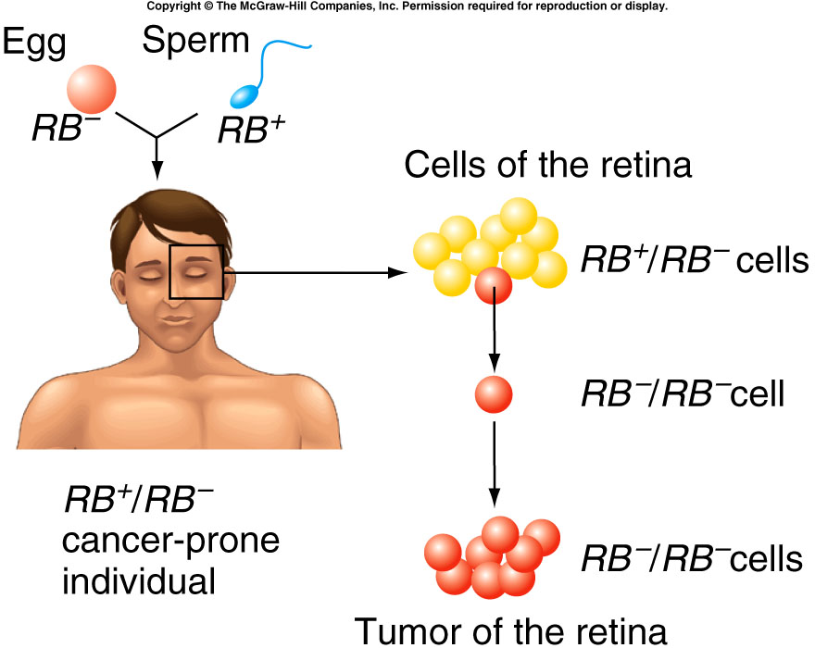
Retinoblastoma: Mutation in Tumor
Suppressor Gene RB

Slide 21
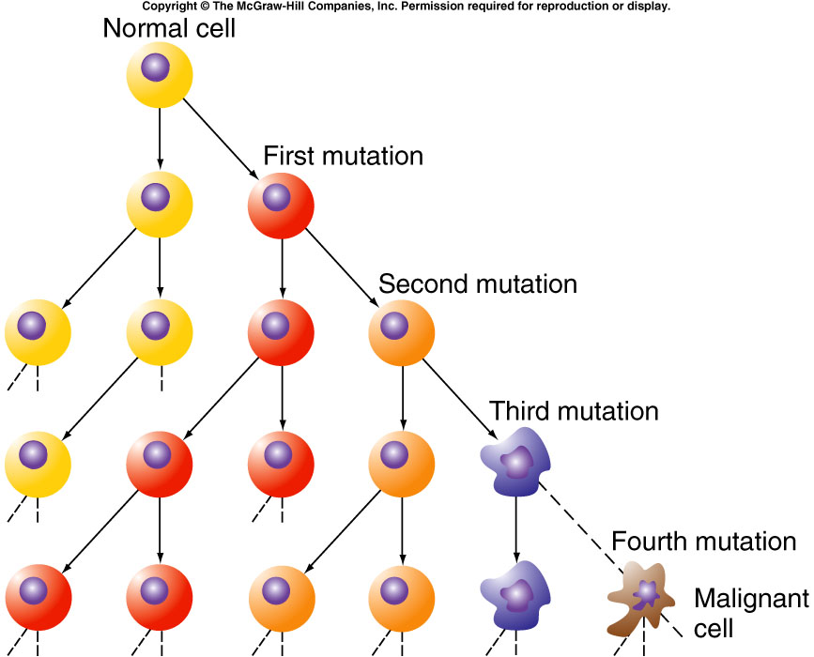
Two (or more) Hit Hypothesis
Cancer: many mutations that lead to lack of cell cycle control
Knudson’s 2-hit hypothesis

Slide 22
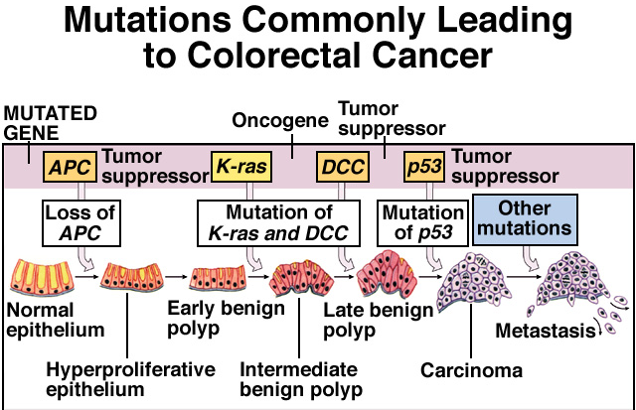
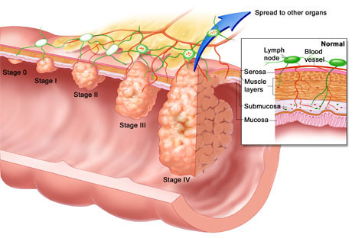
Multiple Mutations
Eventually Lead to
Highly Malignant
Tumors (spread!!)

Slide 23
Causes of Cancer
Chemical carcinogens
Hormones
Radiation
Viruses
Genetic predisposition
Notes:
23

Slide 24
Carcinogens
Mutagen: Agent that causes mutations
Carcinogen: Chemical (usually a mutagen) that causes cancer
Heredity can “predispose” someone to cancer but the environmental mutagens may lead to actual cancer

Slide 25
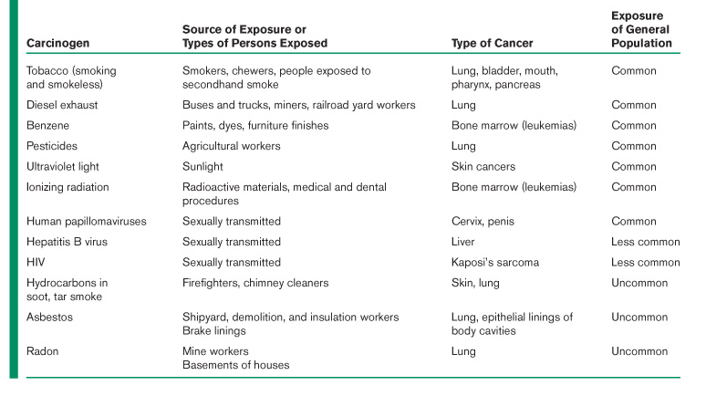
Many Types of Carcinogens

Slide 26
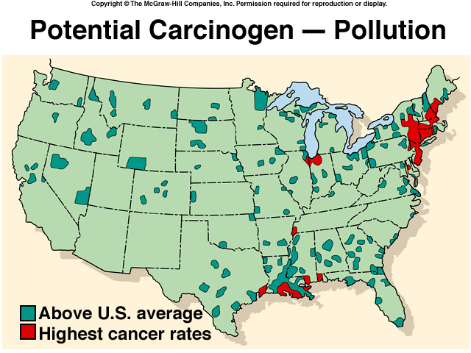

Slide 27
Lung Cancer: Leading Cause of Cancer-related Death
Tobacco Smoke: lots of carcinogens
30% (maybe higher) of cancer can be attributed to cigarette smoking and tobacco use!!
Tobacco-related cancers kill over 400,000 people per year!!
Lung Cancer

Slide 28
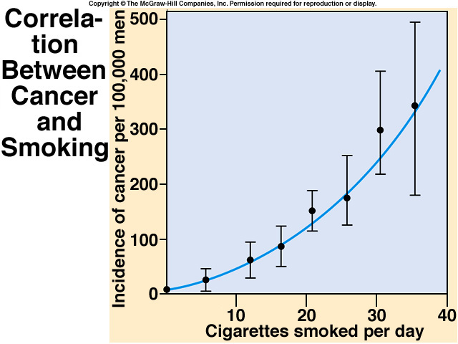

Slide 29
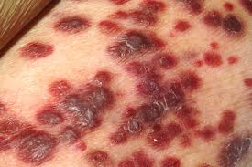
Viruses/Bacteria
Some Examples:
Hepatitis B and C
  Liver cancer
Human Papillomavirus (HPV)
  Cervical cancer
HIV
  Rare cancers like Kaposi’s Sarcoma
Epstein-Barr virus
  Certain types of lymphomas
Heliobacter pylori (stomach ulcer bacteria)
  Stomach cancer
National Cancer Institute, AV-8500-3620
Kaposi’s Sarcoma

Slide 30
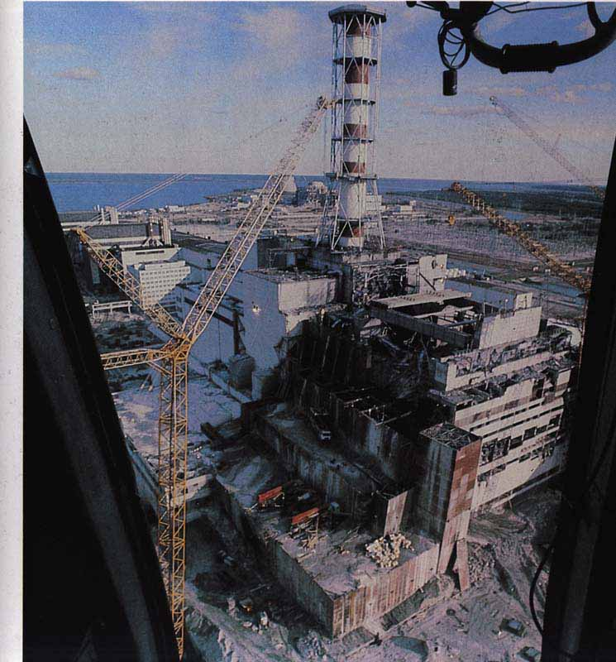
Radiation
Ultraviolet radiation: skin cancer
Radon gas: 2nd leading causes of lung cancer
Nuclear radiation: like Chernobyl in Ukraine
  Area near accident site has seen incredibly high cancer rates
Chernobyl

Slide 31
Diet and Cancer
Overweight and obesity contribute to 14% to 20% of all cancer-related mortality
Diet in processed and red meat, potatoes, refined grains, and sugar-sweetened beverages and foods = increased risk of developing cancer
Alcohol consumption: risk factor for cancers of the mouth, pharynx, larynx, esophagus, liver, colorectum, and breast.

Slide 32
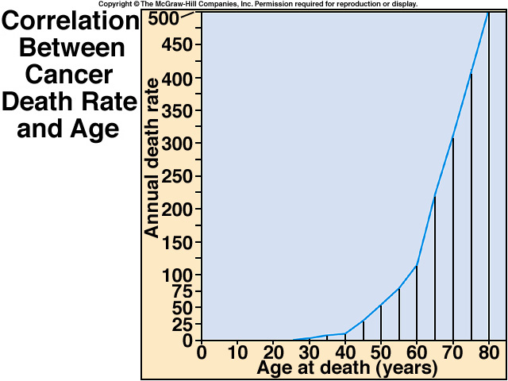
Aging: Number 1 Risk Factor

Slide 33
Signs and Symptoms of Cancer
Pain
Obstruction
Hemorrhage
Anemia
Fracture
Infection
Cachexia
Notes:
33

Slide 34
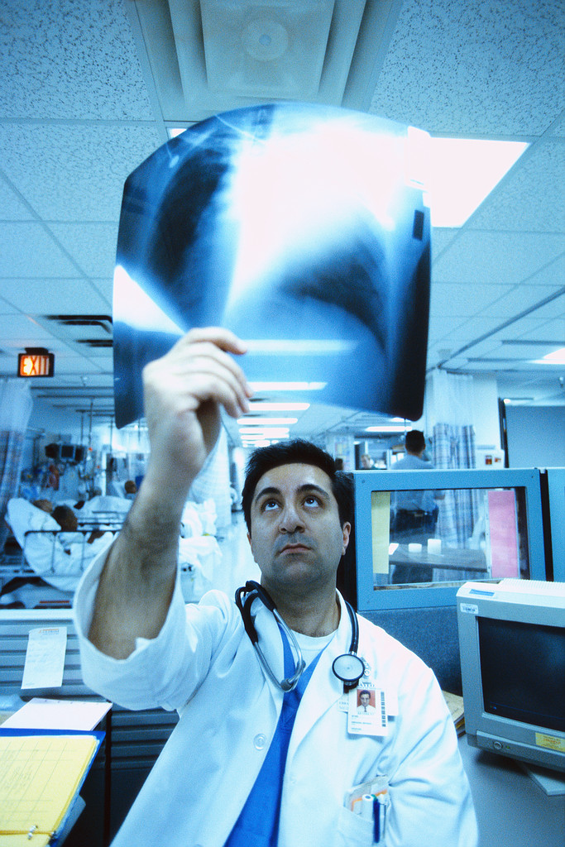
Diagnosis: Many Tests
Tumor imaging
Genetic testing
Enzyme testing
Observation of cancer cells
  Skin
  Pap smear

Slide 35
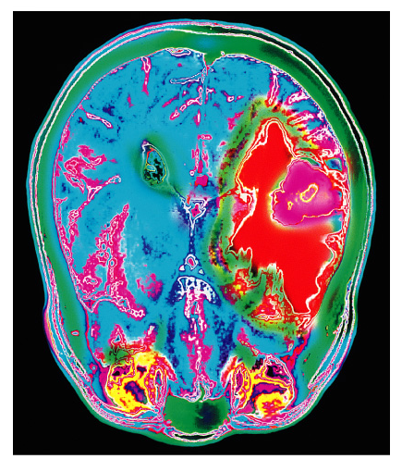
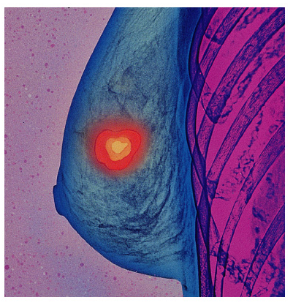
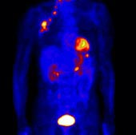
Tumor Imaging
Breast Tumor
- X-RAY
Lung Tumor-
PET scan
Brain Tumor
-MRI

Slide 36

How do doctors treat cancer?
Diagnosis
Resection (surgery)
Radiation
Chemotherapy
New methods of treatment

Slide 37
Chemotherapy
Targets cancer cells that have spread throughout body
  Targets rapidly dividing cells
Main advantage: treats entire body
Most chemo drugs kill cells by damaging DNA or preventing DNA synthesis
Chemo drugs are based on type of cancer, age, health, ability to tolerate potential side effects

Slide 38
Why does Chemotherapy Fail?
Cancer cells resistant to one or several chemo drugs (multidrug resistance)
May not entirely rid the body of cancer
Chemo drugs are toxic to normal cells and can cause many side effects
Chemo may can kill you before the cancer kills you

Slide 39
Diagnosis and Prevention
Most advanced cancer are preventable disease
Early detection is key!!
Not all cancers can be detected early enough
New diagnostic test and awareness are needed for many types of cancers

Slide 40
Summary
Cancer: a group of diseases characterized by uncontrolled growth and spread of abnormal cells.
Mutations can occur in tumor suppressor genes or oncogenes
Multiple mutations are usually required to result in formation of malignant tumor cells
Basic understanding of mechanisms leading to cancer can lead to targeted therapy

