Slide 1
Vaccine Scares in History
Smallpox
Rabies
Yellow Fever
BCG Vaccine-TB

Slide 2
Smallpox
Benjamin Franklin, 1736
Son died of smallpox
Did “buy” the pox
Why?
Fear of getting smallpox from Vaccine
Lady Montague of England
Brought back pox “vaccine in 1721
Basically just ground up smallpox scabs rubbed into cuts, veins
Tested it on prison inmates 1st
1 out of 6 people not inoculated got the virus
1 out of 47 who got inoculated got the virus
Vaccine made out of LIVE VIRUS!!
Cost vs. Benefits

Slide 3
Rabies: Pasteur Vaccine
Saved lots of lives of infected people
1 out of 230 people of every immunized person suffered paralysis or seizures
Why? Made from infected rabbit nerve tissue
Not until 1970s was method of manufacturing the vaccine change from rabbit to human tissue.

Slide 4
Yellow Fever
1942: Thousands of soldiers vaccinated to prevent yellow fever
Stabilizer of the vaccine was human serum
Lots of the human serum was infected with hepatitis A and B (a liver virus)
50,000!!! Soldiers infected with HepA or HepB
Many died

Slide 5
BCG Vaccine
Lubeck, France 1929
Manufacture vaccine using Mycobacterium bovis (infects cows)
Used wrong strain of bacteria!!
Used the actual Mycobacterium tuberculosis
72 babies died, many others infected
Only US and Holland do not use BCG vaccine

Slide 6
The Cutter Incident: Polio Vaccine
1955 Cutter Laboratories manufactures a polio vaccine that GAVE children polio!!
Vaccine inadvertently contained the live, virulent form of the virus
Has resulted in liabilities laws that discouraged companies from developing and producing vaccines to this day

Slide 7
Polio: Debilitating Disease
Polio is a viral illness that, in about 95% of cases, actually produces no symptoms
1-5% of cases can result in neurological deficits including paralysis
The polio virus enters the body through the mouth, usually from hands contaminated with the stool of an infected person.

Slide 8
Polio Virus: How does it Work?
The poliovirus: small RNA virus that has three different strains and is extremely infectious.
The virus invades the nervous system, and the onset of paralysis can occur in a matter of hours.
Over 50% of the cases occurred to children between the ages of three and five.
The incubation period of polio, from the time of first exposure to first symptoms, ranges from three to 35 days.

Slide 9
Polio Epidemics in US
1916 Epidemic in New York City
Paralyzed 9,000 people, killed 2400
Disease spread to all boroughs
Haven Emerson: Instituted quarantine
Children forcibly removed from their homes
His strategy:
Better sanitation
Quarantine suspected cases
Results of his efforts: No drop in Polio cases

Slide 10
More Outbreaks
1921: Outbreaks all over the country
One person infected was Franklin Roosevelt (future president)
Lots of kids infected
Only a few developed severe symptoms but had spend most of their lives in iron lung or were paralyzed

Slide 11
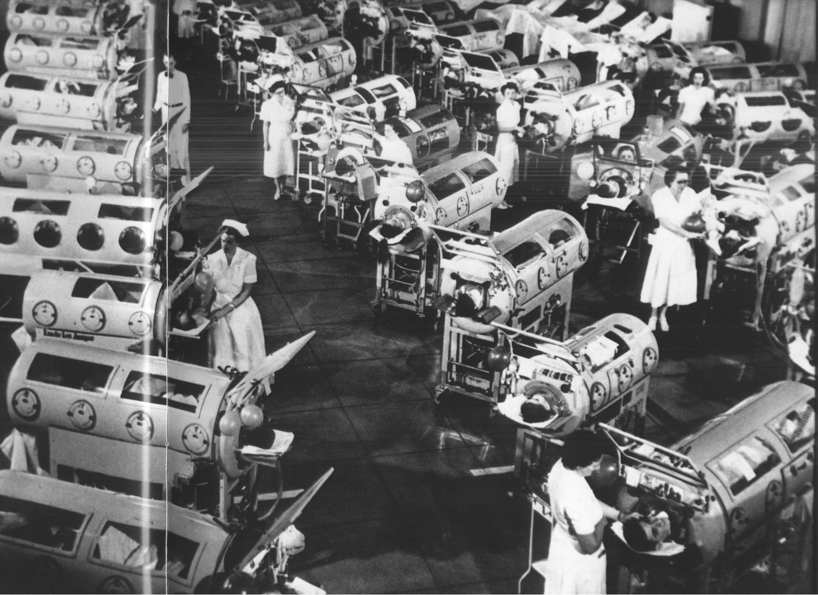
Iron Lung: Helped children breath with damage to their respiratory nerves

Slide 12
The Search for the Polio Vaccine
Vaccine developments for polio had begun in the early 1900’s.
Early attempts failed: researchers did not know there was more than one virus
Understanding about the nature of polio grew through painstaking research over the first half of the twentieth century,

Slide 13
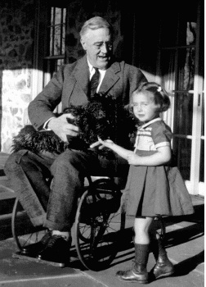
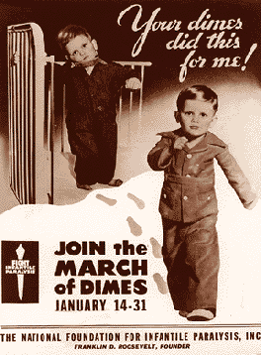
FDR and his associates helped found the March of Dimes
First private organization that help eradicate a childhood disease
Franklin Roosevelt Had Polio

Slide 14
Vaccine Development
Early attempts to develop a vaccine had failed
Scientist did not know that there were only 3 different virus that infected people
1949: discovered all three strains
Question: How do you inactivated or kill the virus but still get a sufficient immune response to prevent infection?

Slide 15
Panic Ensues in The US
1952: The worst recorded polio epidemic in United States history occurs, with 57,628 reported cases
Efforts intensified to find a suitable vaccine
Nation awaited breathlessly
Enter in Jonas Salk

Slide 16
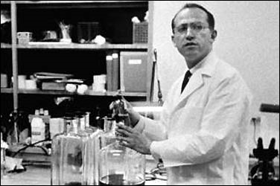
Brilliant, young scientist with cavalier attitude
Began to work in earnest to develop the virus
Developed a virus in 1955
Jonas Salk

Slide 17
Salk Vaccine
1952: Salk was the first to develop a successful vaccine using a mixture of the three types of virus, grown in monkey kidney cultures.
He developed a process using formalin, a chemical that inactivated the whole virus
One of virus was especially resistant to inactivation
Took several years to get conditions correct
Virus was inactivated with long-term exposure with toxic compound (formalin)

Slide 18
Testing The Vaccine
Largest clinical trial in US History
100,000s vaccinated with or without vaccine
Cases fell dramatically in children vaccinated with the vaccine
1955: Massive immunization effort began to vaccine the US population
1955: 260 cases of poliomyelitis, including 10 deaths in people who received a certain vaccine

Slide 19
Polio Vaccine: Huge Success?
1952: 57,628 cases
1960: 2,525 cases
1965: 61 cases
1979: Last reported case in the US
Worldwide: WHO has worked feverishly to vaccinate and eradicate polio

Slide 20
The Cutter Incident
California-based lab
One of many labs to develop vaccine using Salk’s methods
Problem: Did not completely inactivated the most virulent of the three polio viruses used to make vaccine
Resulted in a number of children inadvertently being infected with the virus

Slide 21
The Cutter Incident
Legal precedent has affected the US pharmaceutical industry ever since
Big drug companies less willing to invest money in vaccines due to liability risk

Slide 22
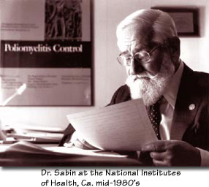
Dr. Sabin developed different vaccine
Contained attenuated virus that could still infectious but was not virulent
Live, oral form given instead of the shot
1980 and 1990, cases averaged 8 per year, and most of those were induced by vaccination
Albert Sabin

Slide 23
The Cutter Incident: Effects
Only 4 companies in US make vaccines
2 out 4 of these are curtailing their research programs
Recent Vaccine Scares
1998: Tetanus shot only given to ERs
2003-2004: Flu killed 36,000
Number of flu shots was low
2005 Flu Vaccine again in limited supply
Since 1998, severe shortages in 9 of 12 vaccine administered to children

