Slide 1
Chapter 8
Cardiovascular System Diseases and Disorders
Notes:
1

Slide 2
Learning Objectives
Define the terminology common to the cardiovascular system and the disorders of the system.
Discuss the basic anatomy and physiology of the cardiovascular system.
Identify the important signs and symptoms associated with common cardiovascular system disorders.
Describe the common diagnostics used to determine type or cause of cardiovascular system disorders.
Identify the common disorders of the cardiovascular system.

Slide 3
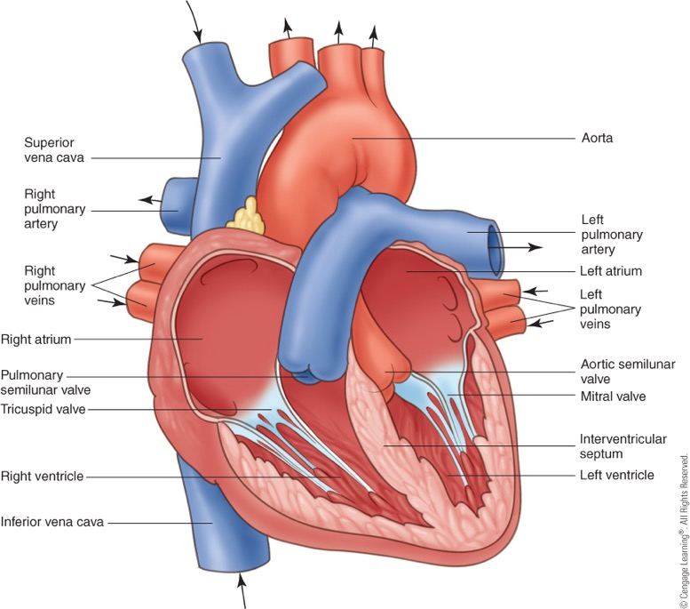
Anatomy and Physiology
Cardiovascular system
Heart, arteries, and veins with blood
Heart
Size of man’s fist
Located slightly left of the middle of the chest
Composed of cardiac muscle, 4 chambers, 4 valves
Notes:
3

Slide 4
The Heart
Notes:
4

Slide 5
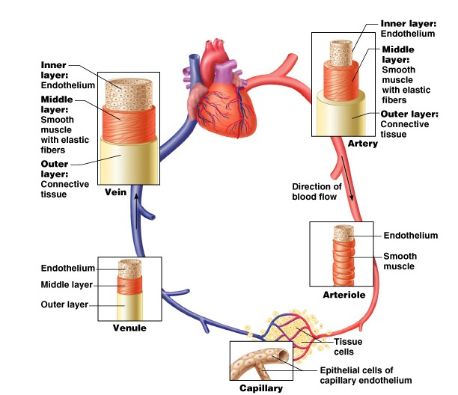
Arteries: Structure and Function

Slide 6
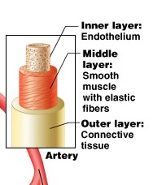
Arteries: Structure and Function
Endothelium: promotes smooth blood flow
Smooth muscles: can vasoconstrict (contract) and vasodilate (relax)
Outer layer: Protects from injury

Slide 7
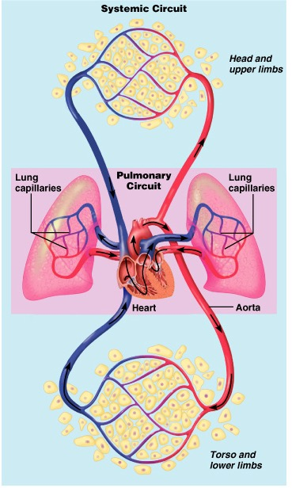
Where does the blood go?
Cardiovascular system
Pulmonary circuit
To the lungs
Systemic circuit
To the body

Slide 9
Cardiac Disease: Common Signs and Symptoms
Chest pain
Shortness of breath
Tachycardia
Cardiac palpitations
Notes:
9

Slide 10
Diagnostic Tests
Noninvasive procedures:
Auscultation
Doppler
Arterial blood pressure
Electrocardiogram
Echocardiography
PET scan
Notes:
10

Slide 11
Diagnostic Tests
Cardiac catheterization
Invasive procedure to determine oxygen content and blood pressure
X-rays
To determine normal function of heart and vessels
urmc.rochester.edu
urmc.rochester.edu
Notes:
11

Slide 12
Diagnostic Tests
Common X-rays:
Angiocardiography
Angiography
Venogram
Blood tests
Enzymes
Creatine phosphokinase (CPK)
Lactate dehydrogenase (LDH)
EKG
measure electrical activity of the heart
Notes:
12

Slide 13
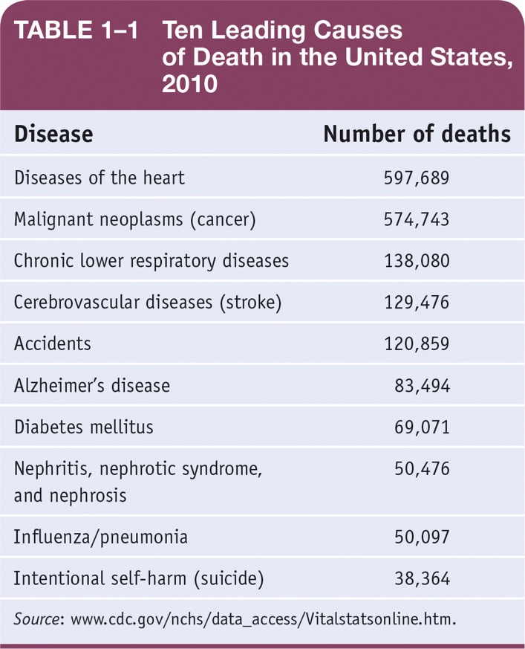
Diseases of the Cardiovascular System
Cardiovascular disease (CVD)
Leading cause of death in the United States
High blood pressure is common cause
Notes:
13

Slide 14
Diseases of Arteries
Hypertension
Indicator of development of cerebrovascular, cardiovascular, and kidney disease
Chronic disease
Leading cause of stroke and heart failure
Notes:
14

Slide 15
Diseases of Arteries
Sphygmomanometer
-Blood Pressure Cuff
Hypertension
Normal blood pressure
120/80
Top number (systolic)
Measures highest pressure in artery when ventricles contract
Bottom number (diastolic)
Measures pressure in artery when ventricles relax
High blood pressure
Greater than 140/90
Notes:
15

Slide 16
Diseases of Arteries
Hypertension
Primary
Idiopathic with gradual onset
Also known as essential hypertension
Risk factors:
Heredity
Diet
Age
Obesity
Smoking
Stress
Notes:
16

Slide 17
Hypertension
Treatment:
Antihypertensive medications
Lifestyle changes
Low-salt diet
Stress-reducing exercise
Smoking cessation
Diuretics
Notes:
17

Slide 18
Diseases of Arteries
Arteriosclerosis and atherosclerosis
Loss of elasticity and thickening of artery wall
Also known as hardening of arteries
Plaque
Deposits of fatty or lipid material in wall of artery
Notes:
18

Slide 19
Diseases of Arteries
Atherosclerosis
Major areas affected:
Coronary arteries
Cerebral arteries
Aorta
Peripheral arteries
Notes:
19

Slide 20
Atherosclerosis
Risk factors:
Controllable factors
Diet
Sedentary lifestyle
Cigarette smoking
Stress
Hypertension
Noncontrollable factors
Heredity
Age
Sex
Diabetes
Notes:
20

Slide 21
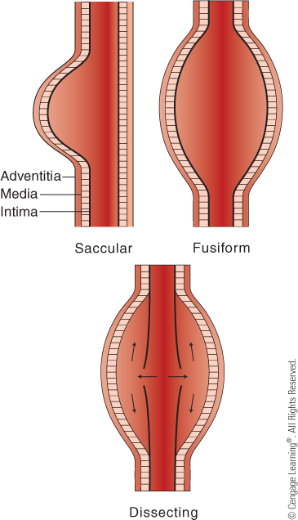
Diseases of Arteries
Aneurysm
Weakening in wall of artery leading to bulge or rupture
Usually asymptomatic and discovered accidentally
Aorta
Most common location
Treatment:
Repairing aneurysm before rupture through resection and grafting
Types of Aneurysms
Notes:
21

Slide 22
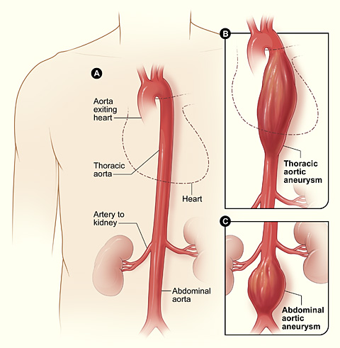
Aneurysms
Ballooning of artery wall
Can reduce blood flow
Rupture: cause internal bleeding
Some have family history
Can take years to develop

Slide 23
Actor from 8 Simple Rules for Dating My Teenage Daughter

Slide 24
Marfan Syndrome Can Lead to Aneurysm

Slide 25
Diseases of Arteries
Coronary artery disease
Narrowing of arteries that supply blood to myocardium
Single leading cause of death in United States
Commonly due to atherosclerosis
Progressive narrowing of vessels may lead to ischemia of heart muscle and symptoms
Lack of blood and oxygen
Scar tissue replaces muscle
Notes:
25

Slide 26
Diseases of Arteries
Coronary artery disease can lead to Myocardial infarction
Death of heart muscle
Treatment
Diagnosis by history, electrocardiogram (ECG), and angiograms
Aimed at increasing blood flow or decreasing oxygen needs
Angina treated with vasodilators
Angioplasty
Coronary artery bypass graft (CABG)
Reduction of atherosclerotic risk factors
Diet
Exercise
Smoking
Notes:
26

Slide 27
Diseases of the Heart
Myocardial infarction
Heart attack
Occurs when heart does not get enough oxygen
Symptoms:
Severe chest pain with diaphoresis and nausea
Referred pain to neck, arm, and jaw with discomfort similar to bad or unrelieved indigestion
Treatment:
Give immediate attention to prevent shock
Relieve respiratory distress
Decrease workload
If cardiac arrest, cardiopulmonary resuscitation (CPR) must be performed
Notes:
27

Slide 28
Diseases of the Heart
Myocardial infarction
Long-Term Treatment:
Oxygen and pain medication
Medications to treat arrhythmias
Clot-busting medications
Education on prevention by lifestyle changes
Smoking cessation
Diet
Exercise
Notes:
28

Slide 29
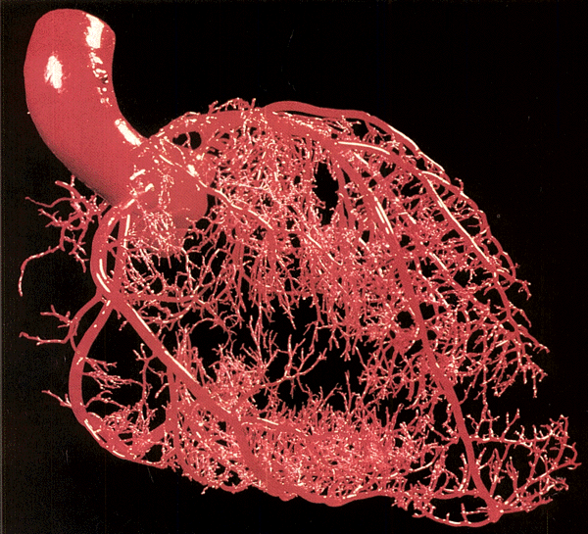
Arteries and Capillaries of the Heart

Slide 30
Coronary Artery Bypass Grafting: CABG
Notes:
30

Slide 31
Source: NIH (Heart, Lung, and Blood Institute)

Slide 33
Diseases of the Heart
Congestive heart failure (CHF)
Heart fails to pump adequate blood supply
Develops slowly and increases workload of heart
Symptoms:
Gradual increase in dyspnea (difficulty breathing)
Tachycardia (rapid heart rate)
Tachypnea (rapid breathing)
Treatment:
Decrease workload
Diuretics
Salt and fluid restrictions
Medications to strengthen and slow heart
Notes:
33

Slide 34
Diseases of the Heart
Arrhythmias
Abnormal heart rhythm
Sinus rhythm is normal heart rhythm
60 to 100 beats per minute
Flutter
Unusually fast heart rate
Fibrillation
Wild and uncoordinated
Heart block
Interruption in conduction system
Notes:
34

Slide 35
Summary
Heart disease is the leading cause of death in the United States
Administration of drugs has helped reduce:
Blood pressure lowering
Cholesterol lowering
Better lifestyle choices
Better diagnostic test
Less severe surgical intervention

