Slide 1
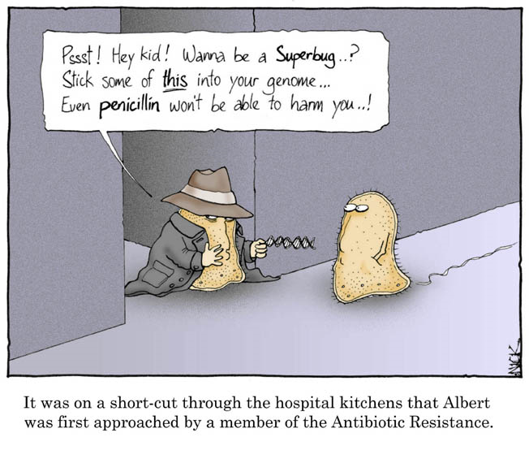
Natural Selection and Antibiotic
Resistance
Lab #5
October 2, 2007

Slide 2
Antimicrobial Drugs: An Historical
Perspective
-- Some ancient cultures regularly packed wounds
with mud
-- Traces of tetracycline can be found in 1,000-year
old Nubian mummies
-- During the late 19th and early 20th centuries,
microbiologists were searching for the “magic
bullet”: a compound that could cure diseases of
bacterial origin
-- Most notably, Paul Ehrlich developed
arsenic-based compounds to treat syphilis

Slide 3
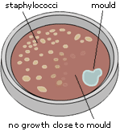
Antimicrobial Drugs: An Historical
Perspective
-- Serendipitously discovered in 1928 by Alexander
Fleming
-- A contaminating mold inhibited the growth of
Staphylococcus
-- Fleming: experience with lysozyme
-- The mold was Penicillium
notatum and it was secreting
penicillin
-- Why would a mold secrete
such a substance?

Slide 4
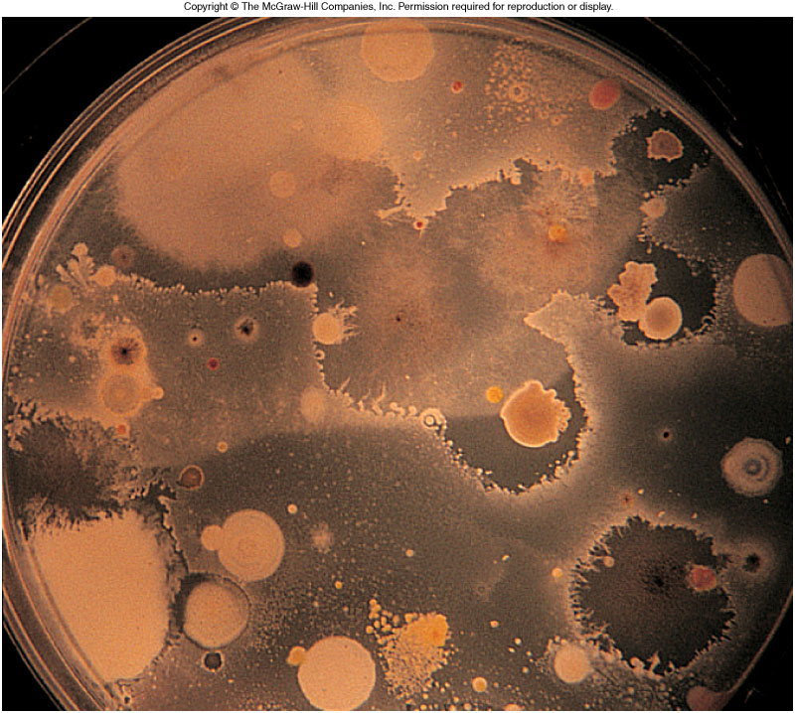
Which Organisms Produce Antibiotics,
and Why?
Bacteria: Commonly Bacillus and Streptomyces
Fungi: Penicillium, Cephalosporium, Aspergillus
Functions? Provides a competitive advantage in the
wild (these guys are never found in pure culture in
the wild!)

Slide 5
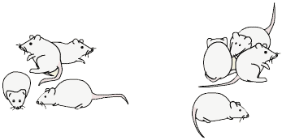
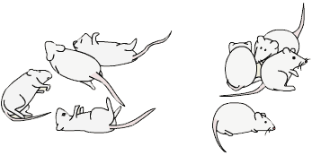
Antimicrobial Drugs: An Historical
Perspective
-- In 1940 Ernest Chain and Howard Florey tested
penicillin’s use in live animals
Streptococcus
Streptococcus
Wait…
Inject with penicillin

Slide 6
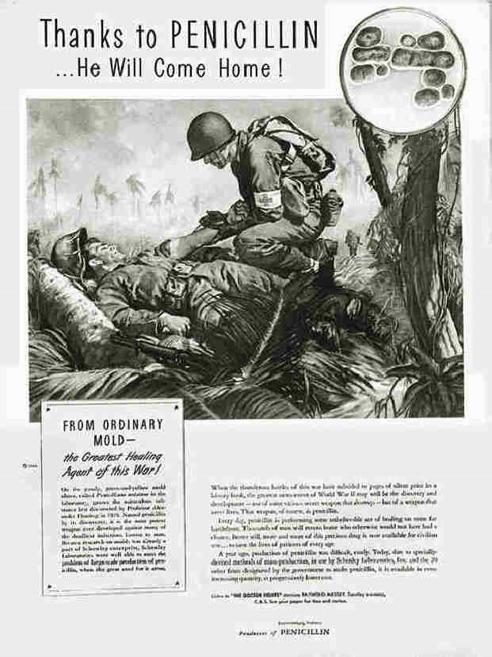
-- Penicillin was not
well known before this,
and was reserved for
military use
-- It was not purified,
and was administered
as a culture filtrate
-- By 1944, however, it
became available for
civilian use

Slide 7
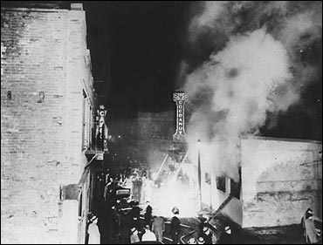
Antimicrobial Drugs: An Historical
Perspective
-- 1942: Boston’s Cocoanut Grove night club burns,
killing 492 patrons
-- Many others hospitalized with severe burns;
usually these individuals were doomed to die of
infection
-- Penicillin was acquired
(32 liters of culture
filtrate) and successfully
prevented infection in
the victims

Slide 8
Antimicrobial Drugs: An Historical
Perspective
-- Jubilation! We’ve finally conquered infectious
disease!
-- By the 1950’s, penicillin was available over the
counter, and was included in skin creams, throat
lozenges, and became available in oral form
Fleming warned: “the greatest possibility of evil in self-medication is the
use of too small doses so that instead of clearing up an infection, the microbes are
educated to resist penicillin and a host of penicillin-fast organisms is bred out
which can be passed to other individuals and from them to others until they reach
someone who gets a septicemia or a pneumonia which penicillin cannot save”
-- By 1946, 14% of staphylococci isolated from
patients in one London hospital were penicillin-fast

Slide 9
Antimicrobial Drugs: An Historical
Perspective
-- By 1950, 59% of Staphylococcus infections were
penicillin resistant (in that same London hospital)
-- Others were now examining soil bacteria for
antibiotic producers; Selman Waksman identified
streptomycin in 1943
-- mid-50’s: prescription required for antibiotics

Slide 10
What Does Streptomycin Do?
-- Streptomycin interacts with bacterial ribosomes
and causes errors in protein synthesis

Slide 11
Natural Selection—Streptomycin
Resistance
-- Small changes in the ribosome reduce or eliminate
streptomycin binding—now it has reduced or no
effects

Slide 12
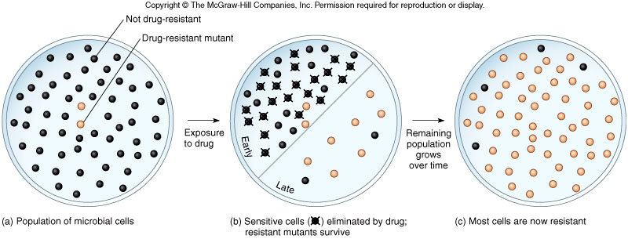
Resistance by Spontaneous Mutation
-- By random chance, an error in DNA replication may
confer a selective advantage on a cell.
-- Keep in mind that this is rare, but we are talking
about enormous populations
-- In the presence of the drug, these resistant
organisms dominate the population

Slide 13
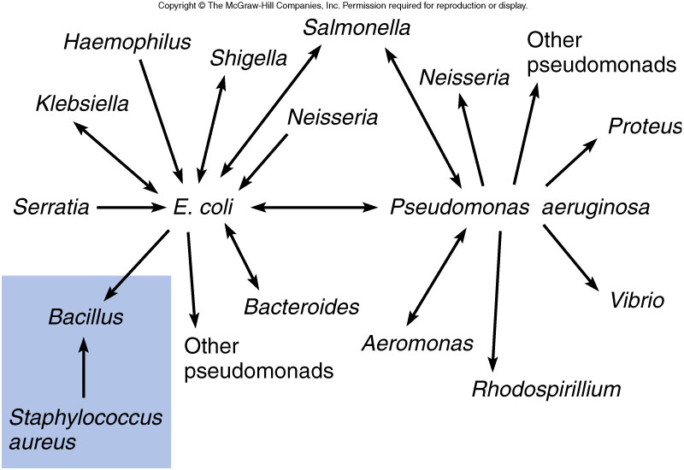
R (Resistance) Factors
-- Mobile genes that confer resistance to one
or more drugs on the host
-- Can spread very rapidly among species

Slide 16
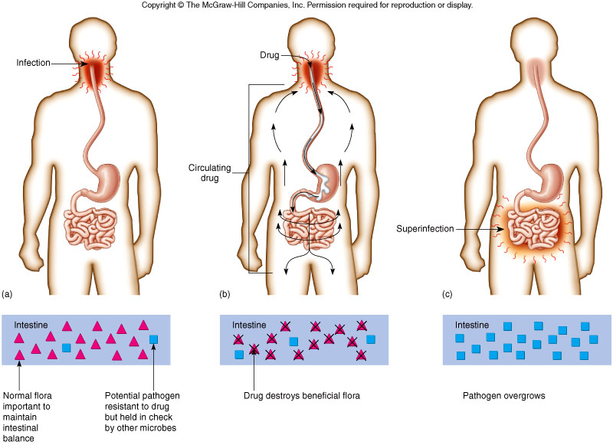
Superinfection!

