Slide 1
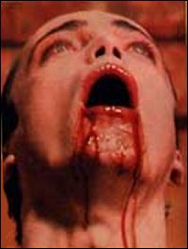
Blood and Blood Disorders

Slide 2
Learning Objectives
Define the terminology common to the blood and blood-forming organs and the disorders of the blood and blood-forming organs.
Discuss the anatomy/physiology of the blood and blood-forming organs.
Describe the common diagnostics used to determine the type/cause of the blood
Identify the common disorders of the blood

Slide 3
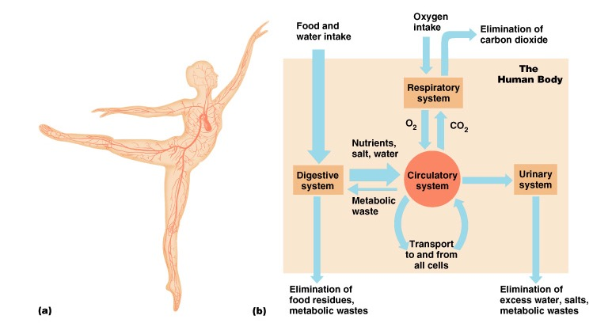
Circulatory system
Circulatory system includes heart, lungs, and blood vessels

Slide 4
3 Functions of Blood
Transportation
  Oxygen, nutrients, waste
Regulation
  Body temp, pH, volume of water
Defense
  Immune cells fight infection

Slide 5
How much blood do you have?
Men: 5-6 liters (1.5 gallons)
Women: 4-5 liters
Total body weight: 8% of your body weight

Slide 6
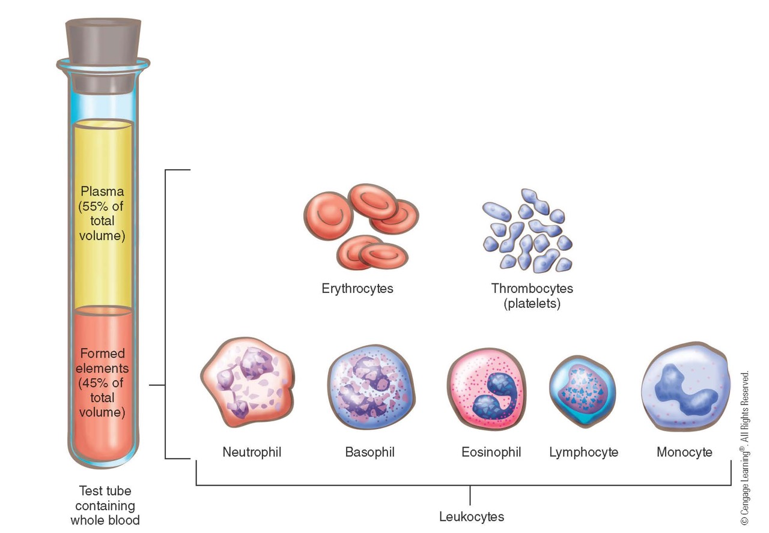
Blood Components
Notes:
6

Slide 7
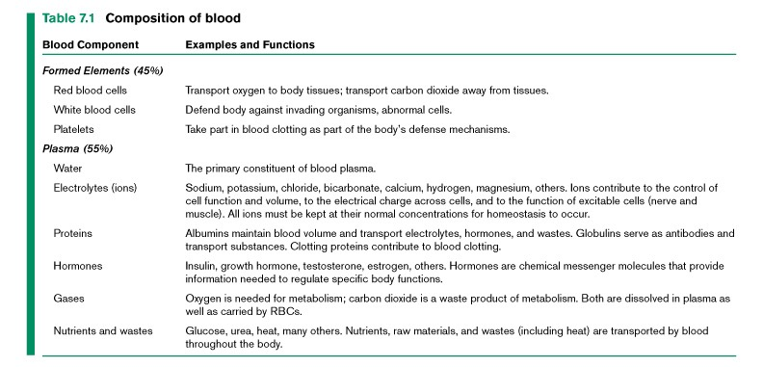
What do the components do?

Slide 8
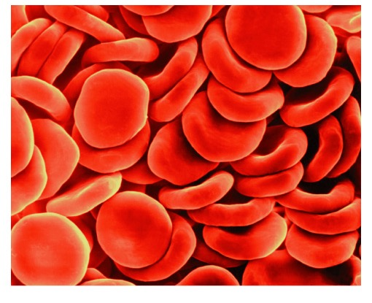
Red Blood Cells (Erythrocytes)
Carry Oxygen and Carbon Dioxide
5 million RBCs per cubic millimeter!!
Cells that have a special oxygen carrying protein called hemoglobin
Life span – 120 days

Slide 9
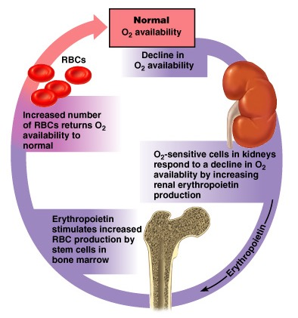
RBC Production: Negative Feedback
Regulated by erythropoieten (EPO)
Stimulates bone marrow to produce more RBCs
Less EPO, less RBCs so blood does not become too thick

Slide 10
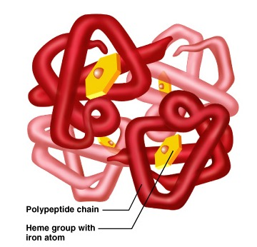
How do RBCs hold Oxygen?
Consists of four protein chains
At center is an iron group (heme) that helps bind oxygen gas
Each RBC can hold up 1.2 billion molecules of oxygen gas

Slide 11
More about Hemoglobin
Hemoglobin important in oxygen transport
Normal hemoglobin:
  Male
    13.5 to 18 hemoglobin in grams (g)/100 milliliters (ml)
  Female
    12 to 16 g/100 ml
Notes:
11

Slide 12
Other Cells: Leukocytes and Platelets
Leukocytes protect individual from infection
  Normal count:
    4,500 to 11,000 mm³
Platelets
  Also known as thrombocytes
  Important in blood clotting
  Normal count:
    150,000 to 350,000 mm³
    Note: normal values may vary some from different laboratories or sources
Notes:
12

Slide 13
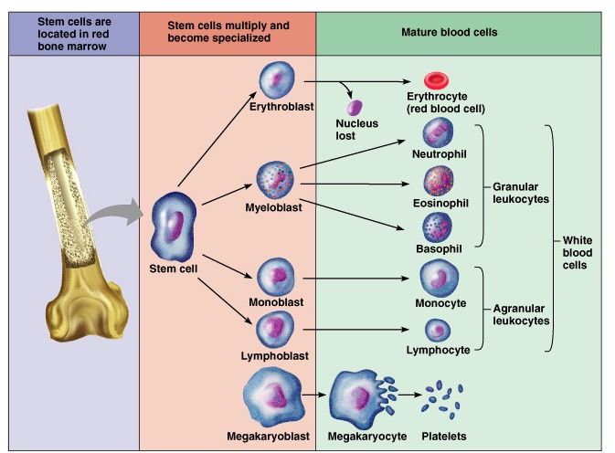
Blood Maturation: All in the bones

Slide 14
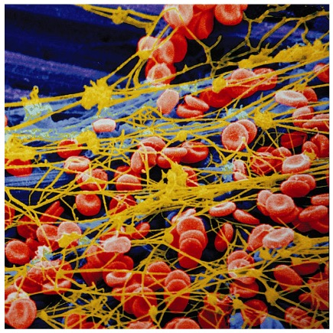
Blood Clotting: Hemostasis
Platelets: essential for blood clotting
Blood vessel leakage leads to the process called hemostasis
Platelets mediate this process

Slide 15
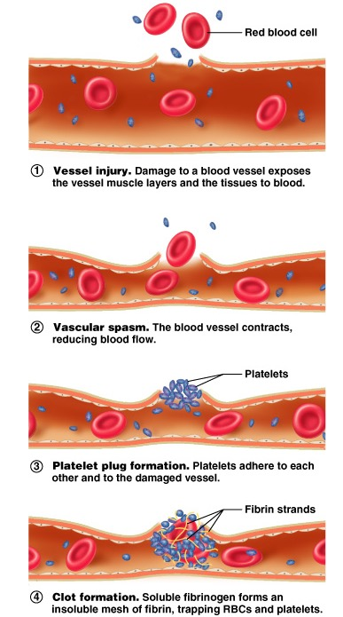
Blood Clotting:
A cascade of events occurs when blood vessel damaged
What is hemophilia?
What common drugs make you bleed more and interfere with clotting?

Slide 16
Anatomy and Physiology
Blood-forming organs:
  Lymph nodes
  Bone marrow
  Spleen
  Liver
Lymph system protects against pathogens
Notes:
16

Slide 17
Abnormal Cell Counts = Disorder
Red Blood Cells
Erythrocytopenia
Erythrocytosis
White Blood Cells
Leukocytopenia
Leukocytosis
Platelets
Thrombocytopenia

Slide 18
Common Signs and Symptoms
Erythrocytopenia
  Decrease in RBCs leading to anemia
  Symptoms:
    Fatigue
    Headache
    Low RBCs
    Pallor
    Shortness of breath
Notes:
18

Slide 19
Common Signs and Symptoms
Erythrocytosis
  Increased RBCs
  Symptoms:
    High RBCs
    Reddened skin tones
    Bloodshot eyes
    Increased blood volume and pressure
    Increased blood volume of heart
Notes:
19

Slide 20
Common Signs and Symptoms
Leukocytopenia
  Decreased white blood cells
  Weakens immune system
Leukocytosis
  Increased white blood cells
  Normal response to acute infections
Notes:
20

Slide 21
Common Signs and Symptoms
Thrombocytopenia
  Decreased platelet count leading to coagulation problem
  Symptoms:
    Petechiae
      Small hemorrhages in skin
    Ecchymoses
      Large areas of bruising or hemorrhage
    Epistaxis, also called a nosebleed
    Bleeding in mouth, gums, and mucous membranes
Notes:
21

Slide 22
Diagnostic Tests
Complete blood count with differential and indices
Biopsy of blood-forming organs
Hematocrit (Hct) reflects amount of red cell mass as proportion of whole blood
Hemoglobin (Hgb) reflects blood’s oxygen-carrying potential
Notes:
22

Slide 23
Diagnostic Tests
Bleeding time determines platelet disorders
  E.g., hemophilia, thrombocytopenia, disseminated intravascular coagulation
Prothrombin time (PT), partial thromboplastin time (PTT), and international normalized ratio (INR) measure blood’s ability to clot
Notes:
23

Slide 24
Disorders of Red Blood Cells
Anemia (many types)
  Iron Deficiency
  Folic Acid
  Pernicious
  Hemolytic
  Sickle-cell
  Aplastic

Slide 25
Disorders of Red Blood Cells
Anemia
  Decrease in oxygen-carrying ability of RBC
  Symptoms:
    Pallor
    Fatigue
    Shortness of breath
    Tachycardia (increased heart rate)
    Headache
    Irritability
    Syncope
Notes:
25

Slide 26
Disorders of Red Blood Cells
Iron deficiency anemia
  Loss of iron or inadequate intake of iron
  Causes:
    Blood loss
    Low dietary intake
  Treatment:
    Increase dietary intake of iron
Notes:
26

Slide 27
Disorders of Red Blood Cells
Folic acid deficiency anemia
  Folic acid needed for maturation of RBCs
  Causes:
    Poor diet
    Overcooking of vegetables
    Overconsumption of alcohol
  Treatment:
    Increase folic acid intake by eating green and yellow vegetables
Notes:
27

Slide 28
Disorders of Red Blood Cells
Pernicious anemia
  Lack of intrinsic factor leading to inadequate absorption of vitamin B₁₂
  Treatment:
    Monthly injections of vitamin B₁₂ for life
Notes:
28

Slide 29
Disorders of Red Blood Cells
Hemolytic anemia
  Destruction of RBCs related to antibody–antigen reaction
  Disorder of immune system leading to destruction of erythrocytes
  Treatment:
    Exchange transfusion and/or splenectomy
Notes:
29

Slide 30
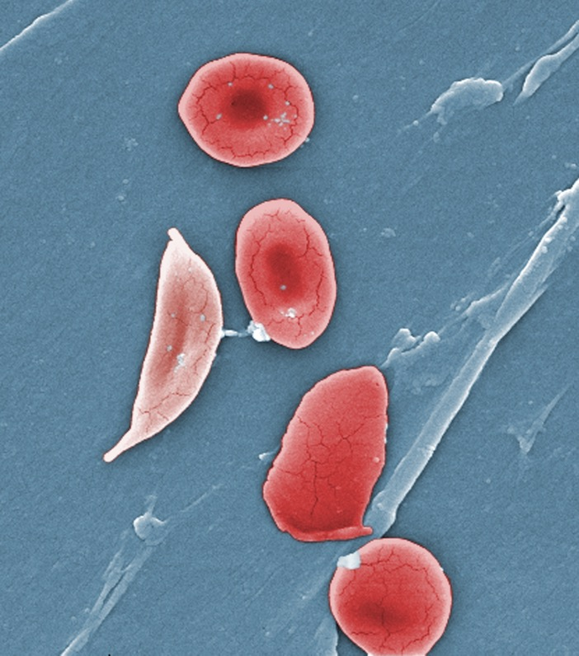
Disorders of Red Blood Cells
Sickle cell anemia
  Hereditary
  Found in African American race
  Abnormal sickle shape of erythrocyte
    Does not allow cell to travel smoothly through vessels
  Symptomatic treatment
  No cure
Notes:
30

Slide 31
Sickle-Cell
Normal Red Blood Cells

Slide 32
Disorders of Red Blood Cells
Aplastic anemia
  Failure of bone marrow to produce blood components
  Causes:
    Chemotherapy
    Radiation
    Viruses
    Toxins
  Treatment:
    Avoid causative agent
    Bone marrow transplantation
    Transfusions
Notes:
32

Slide 33
Disorders of White Blood Cells
Mononucleosis
Leukemia
Hodgkin’s Disease
Multiple myeloma
Notes:
33

Slide 34
Disorders of White Blood Cells
Mononucleosis
  Caused by virus (usually Epstein-Barr Virus)
  Symptoms:
    Fatigue
    Sore throat
    Swollen glands
Notes:
34

Slide 35
Disorders of White Blood Cells
Leukemia
  Malignant neoplasm of blood-forming organs
  Abnormal production of immature leukocytes
  May be acute or chronic
  Acute forms affect children, progress rapidly, and may be fatal
Notes:
35

Slide 36
Disorders of White Blood Cells
Leukemia
  Chronic forms affect older adults, are often asymptomatic, and may not be fatal
  Classified as:
    Myelogenous
      Affecting bone marrow
    Lymphocytic
      Affecting lymph nodes
Notes:
36

Slide 37
Disorders of White Blood Cells
Leukemia
  Symptoms:
    Fatigue
    Headache
    Sore throat
    Dyspnea
    Bleeding of mucous membranes of mouth and gastrointestinal (GI) system
    Bone and joint pain
    Enlargement of lymph nodes, liver, and spleen
    Infections common
Notes:
37

Slide 38
Disorders of White Blood Cells
Leukemia
  Diagnosis by bone marrow biopsy
  Two major types:
    CML (Chronic Myeloid Leukemia)
    AML (Acute Myeloid Leukemia)
  Treatment:
    Aggressive chemotherapy
    Once in remission, bone marrow transplant to replace neoplastic tissue with normal tissue
    Remission at 50%
Notes:
38

Slide 39
Chronic Myeloid Leukemia
A cancer of the white blood cells (WBCs)
Usually occurs in older individuals
  There has been an increase in cases due to the aging of our population
Three phases:
  Chronic – usually treatable
  Accelerated – more difficult to treat
  Blastic - usually very severe symptoms

Slide 40
CML

Slide 41
Gleevac-Targeted Cancer Therapy

Slide 42
Acute Myeloid Leukemia (AML)
Mostly occurs in adults but can also occur in children
AML is caused by abnormalities in the DNA that controls development of cells in your bone marrow.
If you have AML, your bone marrow creates countless WBCs that are immature. These abnormal cells eventually become leukemic WBCs called myeloblasts.
These abnormal cells build up and replace healthy cells. This causes your bone marrow to stop functioning properly, making your body more susceptible to infections.

Slide 43
Acute Lymphocytic Leukemia (ALL)
Mostly occurs in adults but can also occur in children
About 3 out of 4 leukemias among children and teens are acute lymphocytic leukemia (ALL)
The 5-year survival rate for children with ALL has greatly increased over time and is now more than 85% overall.

Slide 44
Survival Rate of ALL Patients

Slide 45
St. Jude Children’s Research Hospital

Slide 46
Disorders of White Blood Cells
Hodgkin’s disease
  Most common lymphoma
  Symptoms:
    Painless enlargement of lymph nodes in neck
    Weight loss
    Fever
  Primarily affects young adults
    Average age of 35
Notes:
46

Slide 47
Disorders of White Blood Cells
Multiple myeloma
  Malignant neoplasm of plasma cells or B-lymphocytes
  Increases with age
    Peaks in 70s
  Plasma cells multiply abnormally in bone marrow
Notes:
47

Slide 48
Disorders of Platelets
Hemophilia
  X-linked hereditary bleeding disorder
  Several types
    Type A
      Most common
  Male children from asymptomatic mothers
  Lack protein necessary for clot formation
Notes:
48

Slide 49
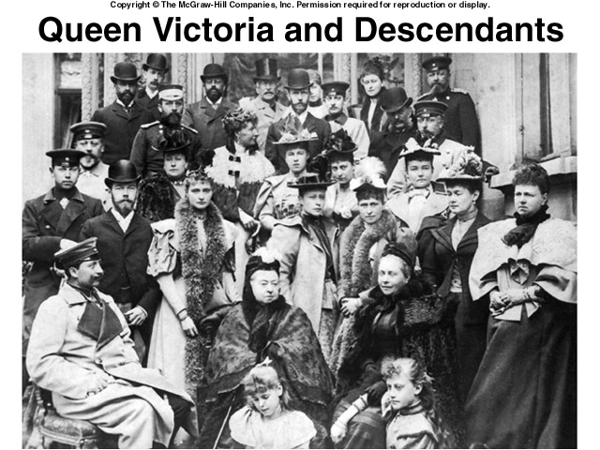

Slide 50
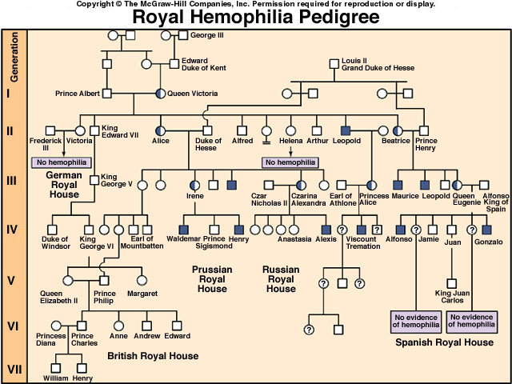

Slide 51
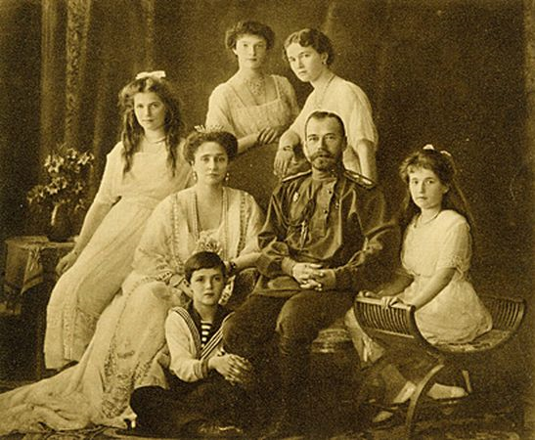
Romanov Family

Slide 52
Disorders of Platelets
Hemophilia
  Symptoms:
    Epistaxis
    Bruising
    Prolonged bleeding
  Diagnosis by blood test
  Treatment:
    Prevention of injury
    Treat symptoms
    Blood transfusions
    Concentrated form of clotting protein
  No cure
Notes:
52

Slide 53
Disorders of Platelets
Disseminated intravascular coagulation (DIC)
  Abnormal clotting followed by abnormal bleeding
  Usually follows major trauma
    E.g., complicated childbirth, surgery, tissue destruction, septicemia, snakebite, shock
  Multiple clots in capillaries
  Life-threatening
Notes:
53

