Slide 1
Vaccines
BIO 140: Introduction to Human Disease

Slide 2
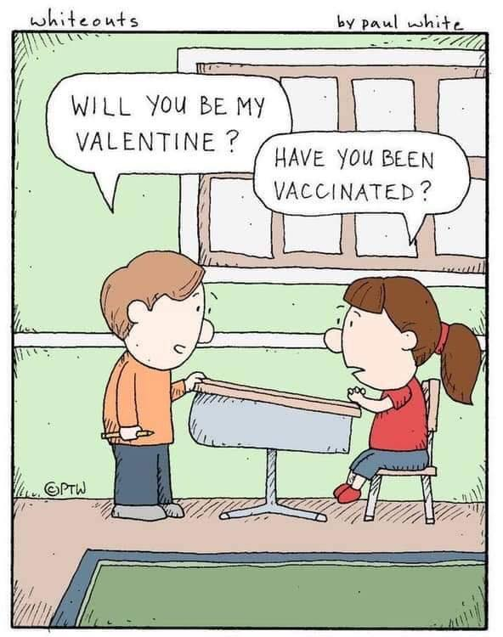
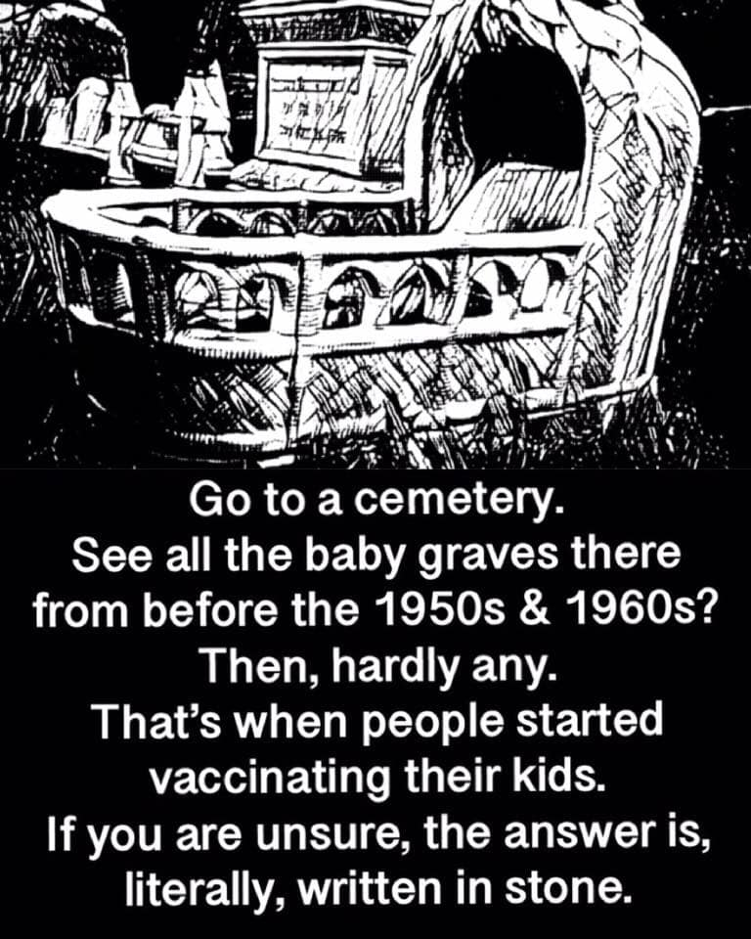

Slide 3
Learning Objectives
Be able to understand how vaccines are formulated and how they protect against infection diseases.
Gain knowledge of the concept of herd immunity and how it helps prevent the spread of infection to un-immunized individuals.
Learn about the success of vaccinations and how they have dramatically reduced the number of disease-related illness.
Understand the limits, safety, and potential risks of vaccines.

Slide 4
What are Vaccines?
Vaccines are harmless derivatives of pathogenic microbes that stimulate the immune system to mount defenses against the harmful pathogen
Vaccines work by exposing your immune system to harmless derivative of infectious agent (i.e. virus or bacteria)
Your immune systems mounts a response against the antigen and then can “store” that response in memory B-Cells
If or when you get exposed to the real infectious agent, your body mounts a vigorous and aggressive immune response

Slide 5
How Vaccines “prime” your Immune Response

Slide 6
Commons Diseases That We Vaccinate Against
Nature Article, 2014
Most of these vaccines are administered in childhood
The outcome of massive and recommend vaccines is the virtually elimination of most of these disease from population (esp. in the United States and Europe)

Slide 7
Department of Human Health Services

Slide 9
CDC

Slide 12
Mumps, Rubella, Measles Vaccine: Example of an Effective Vaccine Against Childhood Diseases
Photo by Brian Snyder/REUTERS

Slide 13
Measles/Rubeola
Measles
Also known as rubeola
Caused by the Rubeola virus
One of the most serious childhood diseases
Commonly spread by contaminated airborne droplets
Symptoms:
Fever
Runny nose
Red maculopapular rash
Koplik’s spots
Photo courtesy the Centers for Disease Control and Prevention

Slide 14
Infographic courtesy the Centers for Disease Control and Prevention

Slide 15
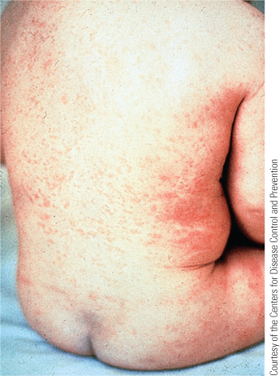
Rubella Rash
Rubella
Caused by Virus
Type of measles
Also known as German measles
In pregnant women may lead to birth defects
Less contagious than rubeola
Symptoms:
Lymph node enlargement, nasal discharge, joint pain, chills, fever
Children and women of childbearing age should be immunized
Photo courtesy the Centers for Disease Control and Prevention

Slide 16
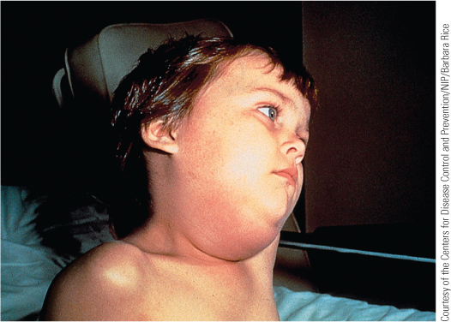
Mumps
Mumps
Caused by the Mumps Virus
Inflammation of parotid glands
Symptoms:
Chills
Fever
Ear pain
Swelling of parotid glands
Complication:
Orchitis and nerve conduction deafness
Photo courtesy the Centers for Disease Control and Prevention

Slide 17
MMR (Measles, Mumps, Rubella) Vaccine
Developed in 1971 by Merck Pharmaceuticals
First dose given to children 9 -15 months of age, second dose at 15 months to 6 years of age
After two doses 97% of people are protected against measles, 88% against mumps, and at least 97% against rubella.
The MMR vaccine is widely used around the world; with over 500 million doses having been given in over 100 countries as of 2001
Measles resulted in 2.6 million deaths per year before immunization became common.
This has decreased to 122,000 deaths per year as of 2012, mostly in low income countries

Slide 18
MMR Vaccinations DO NOT AUTISM
Why the controversy: In 1998, Andrew Wakefield published a study suggesting that MMR Vaccine can lead to autism
This paper was fully retracted by the journal (The Lancet) and every co-author supported the retraction except for Wakefield
Also the preservative was a reagent called Thimerosal that contained a no—toxic form of mercury
It has been replaced with another preservative since 2011
Many very large and longitudinal studies have shown no correlation between the use of this vaccine (with or without Thimerosal) and an increased risk to develop autism
These studies have been conducted worldwide and by top teams of medical professionals and research scientists.

Slide 19
Nature Article, 2014

Slide 21
Nature Article, 2014

Slide 22
Nature Article, 2014

Slide 23
Nature Article, 2014

Slide 25
Nature, 2014

Slide 26
The Flu Vaccine: The Facts
Developed annually to protect against highly variable flu virus
Contains antigens representing 3 (trivalent vaccine) or 4 (quadrivalent vaccine) influenza virus strains
Shown to be relatively effective especially in high risk groups (old, young, immunocompromised)
Side effects are minimal
"The risk-benefit ratio, which is what vaccines and everything in medicine is about, is overwhelmingly in favor of vaccination.” New England Journal of Med

Slide 27
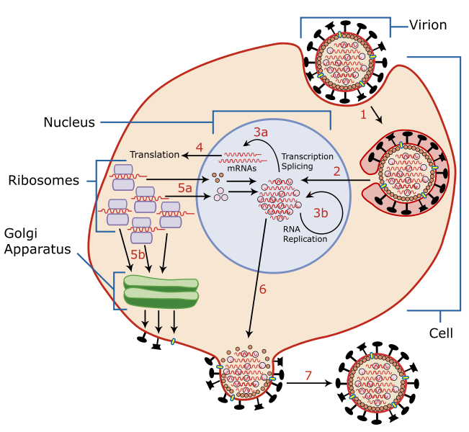
Flu Virus Infection/Replication

Slide 28
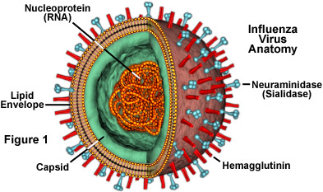
The Flu Vaccine
H = Hemagglutinin
N = Neuraminidase
Example: H1N1 Viral Strain

Slide 29
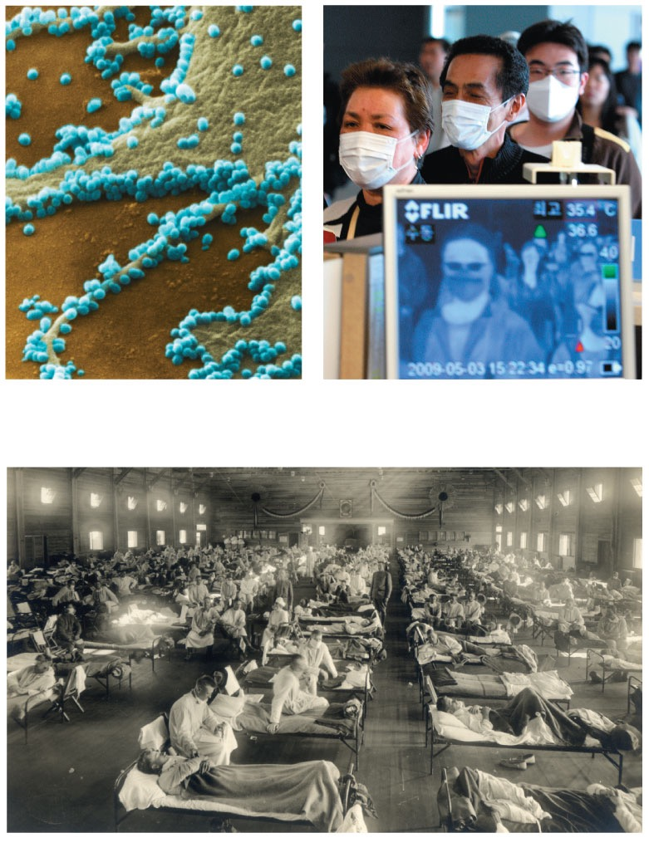
Some strains can cause pandemics, global epidemics
The 2009 flu pandemic was likely passed to humans from pigs;
called the “swine flu”
Normal flu kills up to 500,000 per/year
1 μm
(a)
2009 pandemic H1N1 influenza A virus
(b)
2009 pandemic screening
(c) 1918 flu pandemic
Notes:
Figure 19.9 Influenza in humans.

