Slide 1
Diseases of the Digestive System
Diseases of the Esophagus, Stomach, and Intestines

Slide 2
Learning Objectives
Define the terminology common to the upper and lower digestive system and the disorders of the system.
Discuss the basic anatomy and physiology of the digestive system.
Identify some of the common disorders of the digestive system
Describe the typical course and management of the common digestive system disorders.

Slide 3
Outline of Lecture
Basic Anatomy of the Digestive System (or Gastrointestinal System[GI])
Common Signs and Symptoms of GI Disorders
Disorders of the throat and esophagus
Disorders of the stomach
Disorders of the small and large intestines (colon)
Rare GI disorders

Slide 4
Anatomy and Physiology
Two main purposes:
  Change foods into simpler substances
  Eliminate waste products
Alimentary canal
  Continuous tube running from mouth to anus
NIH.gov
Notes:
4

Slide 5
Anatomy and Physiology
Accessory organs:
  Tongue
  Teeth
  Salivary glands
  Gallbladder
  Pancreas
  Liver
Notes:
5

Slide 6
GI Disorders: Common Signs and Symptoms
Related to hemorrhage, perforation, and altered motility
Terms identifying bleeding:
  Hematemesis
  Hematochezia
  Melena
Notes:
6

Slide 7
GI Disorders: Common Signs and Symptoms
Perforation in stomach or intestines causes peritonitis and septicemia
Alteration in motility can cause nausea, vomiting, diarrhea, and constipation
Notes:
7

Slide 8
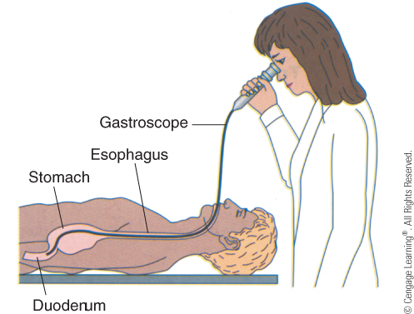
Diagnostic Tests
X-ray
Endoscopic exam
  Esophagogastroduodenoscopy (EGD)
GI series
  Upper GI series – barium swallow
  Lower GI series – barium enema
Occult blood
Ova and parasites
EGD
Notes:
8

Slide 9
Diseases of the Throat/Esophagus
Pharyngitis
  Also known as sore throat
  Viral or bacterial
  Diagnosis by throat culture
  If caused by bacteria, treated with antibiotics
Streptococcal pharyngitis
Notes:
9

Slide 10
Diseases of the Esophagus
Reflux esophagitis
  Also called gastroesophageal reflux disease (GERD)
  Inflammation of tissue at lower end of esophagus
  Caused by backflow of stomach acids through cardiac sphincter upward into esophagus
Notes:
10

Slide 11
Reflux Esophagitis (GERD)
Symptoms:
    Heartburn
    Burning sensation in mid-chest or epigastric area
  Long-term reflux can lead to bleeding, ulceration, and scarring of esophagus
  Treatment:
    Reduce reflux
    Avoid large meals
    Avoid spicy foods, caffeine, and tight clothing
    Take stool softeners
    Take laxatives
    Take antacids and/or anti-reflux medications
    Sleep with head of bed elevated
    Avoid smoking, carbonated beverages, chocolate, high-fat foods, and late-night snacks
Notes:
11

Slide 12
Diseases of the Stomach
Peptic ulcer
  Found in stomach (gastric ulcers) and duodenum (duodenal ulcers)
  Usually caused by H. pylori
  Other causative factors are stress, smoking, drugs such as aspirin, steroids, and alcohol
  Treatment:
    Reduction of contributory factors
    Antacids
    Surgery in severe cases
Notes:
12

Slide 13
Diseases of the Small Intestine: Regional Enteritis
Also known as Crohn’s disease and inflammatory bowel disease (IBD)
  Chronic inflammatory disease most commonly affecting small intestine
  Characterized by remission and exacerbation
Symptoms:
    Anorexia
    Flatulence
    Abdominal pain
    Diarrhea and constipation
  Supportive treatment:
    Low-residue diet
    Medications to control diarrhea, inflammation, infection, and depression
Notes:
13

Slide 14
Diseases of the Colon: Colitis
Chronic inflammation of colon
  Symptoms:
    Lower abdominal pain
    Blood in stools
    Anemia
    Diarrhea
Treatment:
    Dietary limitations
    Stress reduction
    Mild sedatives
    Anti-inflammatories
  Surgery if other treatments unsuccessful
Notes:
14

Slide 15
Diseases of the Colon: IBS
Irritable bowel syndrome (IBS)
  Also known as spastic colon
  Most common intestinal disorder
  Has no inflammation or lesions
  Symptoms:
    Abdominal pain
    Altered motility
    Diarrhea or constipation
Cause is unknown
  Irritants to the colon that may bring on symptoms include:
    Spicy foods and seasonings
    Caffeine
    Alcohol
    Stress
  Treatment:
    Avoidance of irritants
    Stress reduction
Notes:
15

Slide 16
Diseases of the Colon
Colon diseases often require surgical resection
  Hemicolectomy – partial removal of a section of the colon
    Anastomosis – reconnect the two colon ends
  Colectomy – removal of the entire colon
    Colostomy – temporary or permanent opening in the colon
    Stoma – colon opening on the abdominal wall
    Ostomy supplies – one- and two-piece appliances
Notes:
16

Slide 17
Ostomy Bag

Slide 18
Diseases of the Colon: Appendicitis
Appendicitis
  Inflammation of appendix
  Symptoms:
    Abdominal pain that shifts to right lower quadrant (RLQ)
    Nausea and vomiting
    Fever
    Leukocytosis
    Surgical excision
      Preferably before rupture
Notes:
18

Slide 19
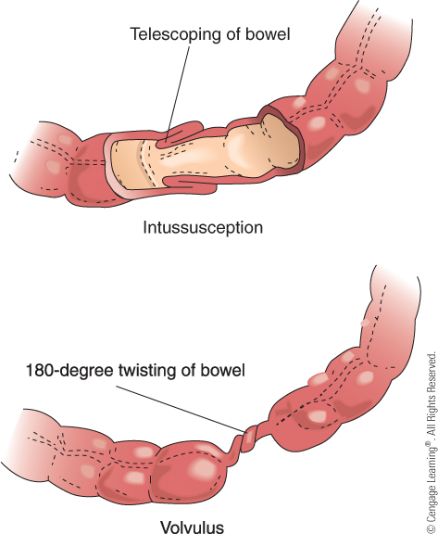
Diseases of the Colon: Obstruction
Intestinal obstruction
  Inability to move contents through intestine
  Obstruction may be due to:
    Blockage – tumors, hernias, adhesions, volvulus, intussusception
    Disease
    Ileus
    Paralytic obstruction
Notes:
19

Slide 20
Diseases of the Colon: Obstruction
Intestinal obstruction
  Symptoms:
    Mild to severe abdominal pain and distention
    Nausea and vomiting
  Treatment:
    Nasogastric suctioning
    Surgery
Notes:
20

Slide 21
Diseases of the Colon: Dysentery
Acute inflammation of colon
Main symptom:
  Massive diarrhea with blood, pus, and mucus accompanied by severe abdominal pain
Treatment dependent on cause
  Antibiotics may be used to treat bacterial infection
Can be caused by bacterial infections such as cholera or E. coli contamination of drinking water
Notes:
21

Slide 22
Diseases of the Colon: Colon Cancer
Carcinoma of the colon and rectum
  Commonly called colorectal cancer
  Symptoms:
    Change in bowel habits
    Pencil-sized stools
    Blood in stools
    Anemia
    Abdominal discomfort and obstruction
Notes:
22

Slide 23
Diseases of the Colon: Colon Cancer
Colorectal cancer
  Adenocarcinomas
    Most common
  Diagnosis by barium enema, stool exams for occult blood, and colonoscopy
  Prevention:
    Diet and stool examinations
Notes:
23

Slide 24
Diseases of the Colon: Colon Cancer
Notes:
24

Slide 25
Rare Diseases
Achalasia
  Disorder of esophagus causing pain with swallowing
Gluten-induced enteropathy
  Also known as celiac disease
  Immune problem causing sensitivity to gluten proteins
Intestinal polyps
  Benign tumors found along intestine lining
  Often surgically removed as a preventive to cancer
Notes:
25

