Slide 1
Describing data sets
AN INTRODUCTION TO DESCRIPTIVE STATISTICS
Day 10

Slide 2
Numerical Descriptions of Data
Measures of Center

Slide 3
Data set {15, 19, 29, 14, 13, 9, 15}
Put the data set in order of smallest value to largest value
9, 13, 14, 15, 15, 19, 29
Mode (most frequently occurring) is ??
Mean (arithmetic average (9+13+14+15+15+19+29)/7) is ??
Median (middle number) is ??
Range (largest number minus smallest number) is ??
Outliers (numbers that fall far outside the data set)??

Slide 4
Data set {15, 19, 29, 14, 13, 9, 15}
Put the data set in order of smallest value to largest value
9, 13, 14, 15, 15, 19, 29
Mode (most frequently occurring) is 15
Mean (arithmetic average (9+13+14+15+15+19+29)/7) is 16.3
Median (middle number) is 15
Range (largest number minus smallest number) is 20
Outliers (numbers that fall far outside the data set) are not present in this series of numbers.

Slide 5
What if the data set is even in number?
To find the mean, mode and range, the procedure is the same.
To find the median, you would average the middle two numbers.
For example: 1, 2, 4, 9, 10 ,13
The middle number, the median, is between 4 and 9 which would be 7.5.

Slide 6
Visual Descriptions of Data
Graphs

Slide 7
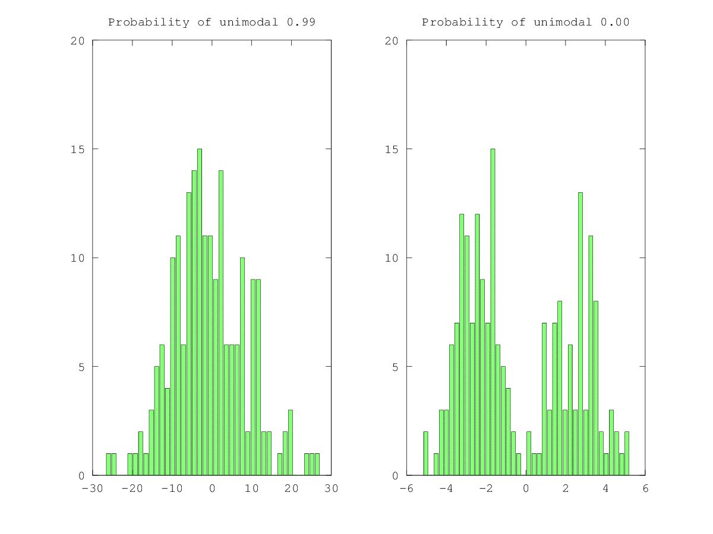
Shape
Unimodal
Bimodal

Slide 8
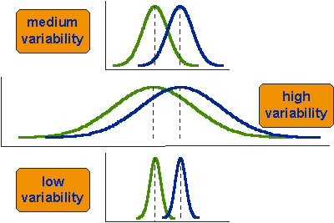
Variation

Slide 9
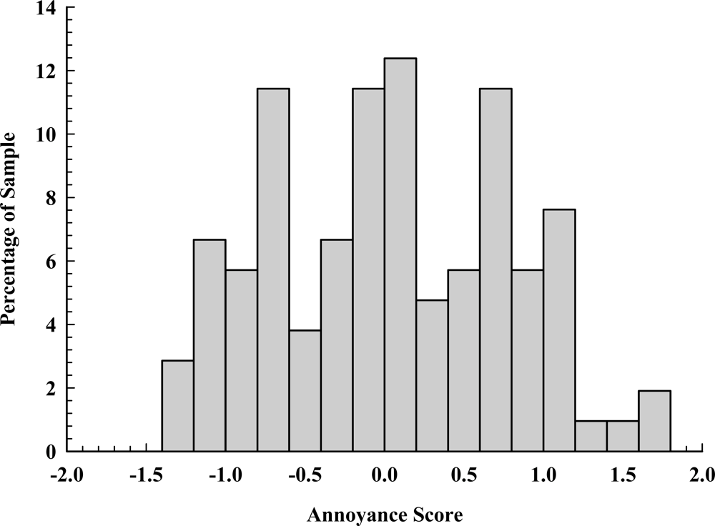
Shape, Variation
Shape (how many peaks)
unimodal
bimodal
multimodal
Variation (low, medium, high)

Slide 10
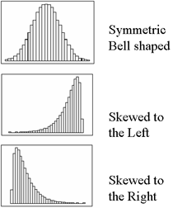
Skew

Slide 11
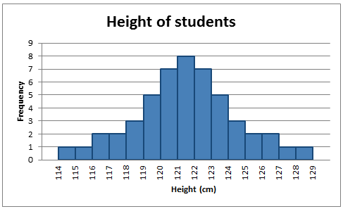
Shape, Variation, Skew
Shape (how many peaks)
unimodal
bimodal
multimodal
Variation (low, medium, high)
Skew
Normal/Symmetric (mean=median=mode)
Left-Skew (mean<median; tails off to left/low end)
Right-Skew (mean>median; tails off to right/high end)

Slide 12
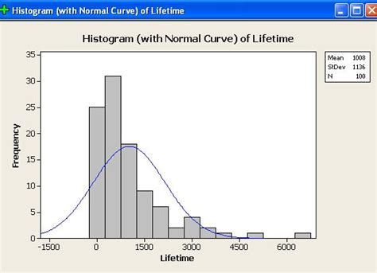
Shape, Variation, Skew
Shape (how many peaks)
unimodal
bimodal
multimodal
Variation (low, medium, high)
Skew
Normal/Symmetric (mean=median=mode)
Left-Skew (mean<median; tails off to left/low end)
Right-Skew (mean>median; tails off to right/high end)

Slide 13
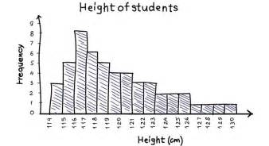
Shape, Variation, Skew
Shape (how many peaks)
unimodal
bimodal
multimodal
Variation (low, medium, high)
Skew
Normal/Symmetric (mean=median=mode)
Left-Skew (mean<median; tails off to left/low end)
Right-Skew (mean>median; tails off to right/high end)

Slide 14
How the Numerical and Visual meet

Slide 15
Measures of Center in a Normal Distribution

Slide 16
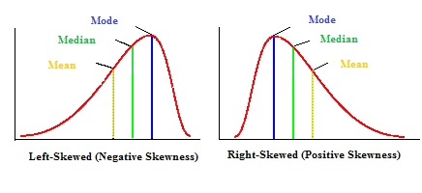
Measures of Center and Skew

